Slide 1
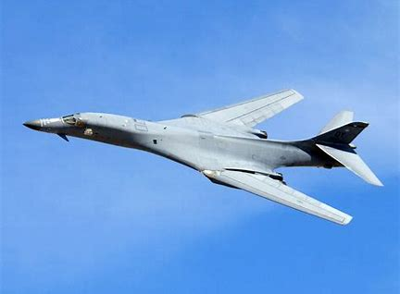
B-1 Lancer

Slide 2
Circuit Card Assembly: AS - Repair Robins AFB – 410 SCMS
MD: | B-1
TMS: | N/A
Noun: | Circuit Card Assembly
NSN: | 5998-01-193-4223
P/N: | 865284-1
Buy Price: | $3,856.25
Date Last Procured: | 9/1/1989
Repair Cost: | $1,246.39
AAC: | V
Surplus Available: | 0
QPA/APPL Rate: | 1 | 100%
Replacement Rate:
AMC/AMSC: | NA | NA
RMC/RMSC: | NA | NA
Material: | Not Available
Dimensions: | Not Available
Criticality Code: | X
Drawings Available: | Yes
Drawing #: | 865284
T.O. Available: | Yes
T.O. #: | 33D7-59-64-4/33D7-59-64-1
Budget Code: | 8
Drawing Cage Code: | 20418
Next Higher Asmbly: | AN/USM-305 DATSA
Out Year Requirements: BUY
FY23: | 0 | FY24: | 0 | FY25: | 0 | FY26: | 0 | FY27: | 0
Out Year Requirements: REPAIR
FY23: | 2 | FY24: | 2 | FY25: | 1 | FY26: | 1 | FY27: | 1
EDL: | Unavailable |  |  |  |  | RDL: | Available
Tinker | ------ |  |  |  |  | Robins | 3/24/2023
Hill | 12/8/2022 |  |  |  |  | Virtual | ------
Comments
Produces seven individually programmable DC reference voltages which are applied through reference supply to establish upper and lower logic levels for the digital stimulus test pattern applied to the UUT.
Deliverables: Source Approval Request (SAR) Package. **NOTE** - SAR package can be combined with item on the next chart for NSN 5998-01-275-4719.
NOTE: Send notification to 429SCMS.SASPO.Workflow@us.af.mil within 45 days of intent to submit SAR package.

Slide 3
Circuit Card Assembly: AS - Repair Robins AFB – 410 SCMS
MD: | B-1
TMS: | N/A
Noun: | Circuit Card Assembly
NSN: | 5998-01-275-4719
P/N: | 865284-301
Buy Price: | $7,235.53
Date Last Procured: | 10/1/1997
Repair Cost: | $5,074.49
AAC: | V
Surplus Available: | 0
QPA/APPL Rate: | 1 | 100%
Replacement Rate:
AMC/AMSC: | NA | NA
RMC/RMSC: | 2 | R
Material: | Not Available
Dimensions: | Not Available
Criticality Code: | Y
Drawings Available: | Yes
Drawing #: | 865284
T.O. Available: | Yes
T.O. #: | 33D7-59-64-4/33D7-59-64-1
Budget Code: | 8
Drawing Cage Code: | 20418
Next Higher Asmbly: | AN/USM-305 DATSA
Out Year Requirements: BUY
FY23: | 0 | FY24: | 0 | FY25: | 0 | FY26: | 0 | FY27: | 0
Out Year Requirements: REPAIR
FY23: | 2 | FY24: | 2 | FY25: | 1 | FY26: | 1 | FY27: | 1
EDL: | Unavailable |  |  |  |  | RDL: | Available
Tinker | ------ |  |  |  |  | Robins | 3/24/2023
Hill | 12/8/2022 |  |  |  |  | Virtual | ------
Comments
Produces seven individually programmable DC reference voltages which are applied through reference supply to establish upper and lower logic levels for the digital stimulus test pattern applied to the UUT.
Deliverables: Source Approval Request (SAR) Package. Please send a request to randy.miller.22@us.af.mil and include your email address and “request a drop off”. A “request for drop off” will be returned, use this to submit your SAR package.
NOTE: Send notification to 429SCMS.SASPO.Workflow@us.af.mil within 45 days of intent to submit SAR package.

Slide 4
Circuit Card Assembly: AS - Repair Robins AFB – 410 SCMS
MD: | B-1
TMS: | N/A
Noun: | Circuit Card Assembly
NSN: | 5998-01-275-5767
P/N: | 866720
Buy Price: | $4,191.91
Date Last Procured: | 9/10/1990
Repair Cost: | $1,844.44
AAC: | V
Surplus Available: | 0
QPA/APPL Rate: | 1 | 100%
Replacement Rate:
AMC/AMSC: | NA | NA
RMC/RMSC: | 2 | R
Material: | Not Available
Dimensions: | Not Available
Criticality Code: | Y
Drawings Available: | Yes
Drawing #: | 866720
T.O. Available: | Yes
T.O. #: | 33D7-59-64-4/33D7-59-64-1
Budget Code: | 8
Drawing Cage Code: | 20418
Next Higher Asmbly: | AN/USM-305 DATSA
Out Year Requirements: BUY
FY23: | 0 | FY24: | 0 | FY25: | 0 | FY26: | 0 | FY27: | 0
Out Year Requirements: REPAIR
FY23: | 2 | FY24: | 2 | FY25: | 1 | FY26: | 1 | FY27: | 1
EDL: | Unavailable |  |  |  |  | RDL: | Available
Tinker | ------ |  |  |  |  | Robins | 3/24/2023
Hill | 12/8/2022 |  |  |  |  | Virtual | ------
Comments
Contains the firmware routines necessary for the CPU to interpret and execute CIIL programmed messages.
Deliverables: Source Approval Request (SAR) Package. Please send a request to randy.miller.22@us.af.mil and include your email address and “request a drop off”. A “request for drop off” will be returned, use this to submit your SAR package.
NOTE: Send notification to 429SCMS.SASPO.Workflow@us.af.mil within 45 days of intent to submit SAR package.

Slide 5
Circuit Card Assembly: AS - Repair Robins AFB – 410 SCMS
MD: | B-1
TMS: | N/A
Noun: | Circuit Card Assembly
NSN: | 5998-01-193-4225
P/N: | 865274-301
Buy Price: | $13,032.97
Date Last Procured: | 8/8/1985
Repair Cost: | $4,691.86
AAC: | V
Surplus Available: | 0
QPA/APPL Rate: | 1 | 100%
Replacement Rate:
AMC/AMSC: | 3 | H
RMC/RMSC: | NA | NA
Material: | Not Available
Dimensions: | Not Available
Criticality Code: | Y
Drawings Available: | Yes
Drawing #: | 865274
T.O. Available: | Yes
T.O. #: | 33D7-59-64-4/33D7-59-64-1
Budget Code: | 8
Drawing Cage Code: | 20418
Next Higher Asmbly: | AN/USM-305 DATSA
Out Year Requirements: BUY
FY23: | 0 | FY24: | 0 | FY25: | 0 | FY26: | 0 | FY27: | 0
Out Year Requirements: REPAIR
FY23: | 3 | FY24: | 3 | FY25: | 3 | FY26: | 3 | FY27: | 3
EDL: | Unavailable |  |  |  |  | RDL: | Unavailable
Tinker | ------ |  |  |  |  | Robins | 3/24/2023
Hill | 12/8/2022 |  |  |  |  | Virtual | ------
Comments
A35 Digital Word Generator RAM Circuit Card Assembly provides 512K bytes of temporary storage memory used by CPU to store pattern and error data.
Deliverables: Source Approval Request (SAR) Package. Please send a request to randy.miller.22@us.af.mil and include your email address and “request a drop off”. A “request for drop off” will be returned, use this to submit your SAR package.
NOTE: Send notification to 429SCMS.SASPO.Workflow@us.af.mil within 45 days of intent to submit SAR package.

Slide 6
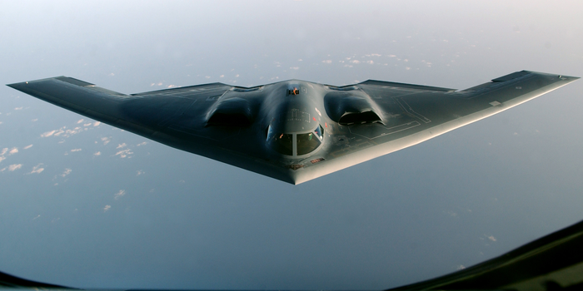
B2

Slide 7
Hose Assy, Non-metallic: AS-New Buy Tinker AFB – 424 SCMS
MD: | B-2
TMS: | N/A
Noun: | Hose Assy, Nonmetallic
NSN: | 4720-01-362-3480
P/N: | DAA3515A010-009
Buy Price: | $1862.00
Date Last Procured: | 11/01/1993
Repair Cost: | $
AAC: | Z
Surplus Available: | No
QPA/APPL Rate: | 1 | 100%
Replacement Rate: | 0%
AMC/AMSC: | 3 | D
RMC/RMSC: | N/A | N/A
Material: | Rubber, Fluorosilicone Elastomer
Dimensions:
Criticality Code: | X
Drawings Releasable: | No
Drawing #: | DAA3515A011
T.O. Releasable:
T.O. #:
Budget Code: | 9
Drawing Cage Code: | 1W025
Next Higher Asmbly: | DAA3515A010
Out Year Requirements: BUY
FY23: | 10 | FY24: | 0 | FY25: | 0 | FY26: | 0 | FY27: | 0
Out Year Requirements: REPAIR
FY23: | 0 | FY24: | 0 | FY25: | 0 | FY26: | 0 | FY27: | 0
EDL: | unavailable |  |  |  |  | RDL: | unavailable
Tinker | ------ |  |  |  |  | Robins | 3/24/2023
Hill | ------ |  |  |  |  | Virtual | ------
Comments
Deliverables: Source Approval Request (SAR) Package
Interested vendors should submit a Source Approval Request (SAR) to dlaavnsmallbus@dla.mil.
NOTE: Send notification to 429SCMS.SASPO.Workflow@us.af.mil within 45 days of intent to submit SAR package.

Slide 8
Hose Assy, Non-metallic: AS-New Buy Tinker AFB – 424 SCMS
MD: | B-2
TMS: | N/A
Noun: | Hose Assy, Nonmetallic
NSN: | 4720-01-362-3481
P/N: | DAA3515A011-017
Buy Price: | $1862.00
Date Last Procured: | 02/01/1999
Repair Cost: | $
AAC: | Z
Surplus Available: | No
QPA/APPL Rate: | 1 | 100%
Replacement Rate: | 0%
AMC/AMSC: | 4 | P
RMC/RMSC: | N/A | N/A
Material: | Rubber, Fluorosilicone Elastomer
Dimensions:
Criticality Code: | X
Drawings Releasable: | No
Drawing #: | DAA3515A011
T.O. Releasable:
T.O. #:
Budget Code: | 9
Drawing Cage Code: | 1W025
Next Higher Asmbly: | DAA3515A010
Out Year Requirements: BUY
FY23: | 10 | FY24: | 0 | FY25: | 0 | FY26: | 0 | FY27: | 0
Out Year Requirements: REPAIR
FY23: | 0 | FY24: | 0 | FY25: | 0 | FY26: | 0 | FY27: | 0
EDL: | unavailable |  |  |  |  | RDL: | unavailable
Tinker | ------ |  |  |  |  | Robins | 3/24/2023
Hill | ------ |  |  |  |  | Virtual | ------
Comments
Deliverables: Source Approval Request (SAR) Package
Interested vendors should submit a Source Approval Request (SAR) to dlaavnsmallbus@dla.mil.
NOTE: Send notification to 429SCMS.SASPO.Workflow@us.af.mil within 45 days of intent to submit SAR package.

Slide 9
Hose Assy, Non-metallic: AS-New Buy Tinker AFB – 424 SCMS
MD: | B-2
TMS: | N/A
Noun: | Hose Assy, Nonmetallic
NSN: | 4720-01-362-3482
P/N: | DAA3515A011-019
Buy Price: | $ 247.28
Date Last Procured: | 11/7/2019
Repair Cost: | $ 101.46
AAC: | D
Surplus Available: | No
QPA/APPL Rate: | 1 | 100%
Replacement Rate: | 0%
AMC/AMSC: | 3 | P
RMC/RMSC: | N/A | N/A
Material: | Rubber, Fluorosilicone Elastomer
Dimensions:
Criticality Code: | X
Drawings Releasable: | No
Drawing #: | DAA3515A011
T.O. Releasable:
T.O. #:
Budget Code: | 8
Drawing Cage Code: | 81205
Next Higher Asmbly: | DAA3515A010
Out Year Requirements: BUY
FY23: | 14 | FY24: | 0 | FY25: | 0 | FY26: | 0 | FY27: | 0
Out Year Requirements: REPAIR
FY23: | 0 | FY24: | 0 | FY25: | 0 | FY26: | 0 | FY27: | 0
EDL: | unavailable |  |  |  |  | RDL: | unavailable
Tinker | ------ |  |  |  |  | Robins | 3/24/2023
Hill | ------ |  |  |  |  | Virtual | ------
Comments
Deliverables: Source Approval Request (SAR) Package
Interested vendors should submit a Source Approval Request (SAR) to 429SCMS.SASPO.Workflow@us.af.mil
NOTE: Send notification to 429SCMS.SASPO.Workflow@us.af.mil within 45 days of intent to submit SAR package.

Slide 10
Hose Assy, Non-metallic: AS-New Buy Tinker AFB – 424 SCMS
MD: | B-2
TMS: | N/A
Noun: | Hose Assy, Nonmetallic
NSN: | 4720-01-362-3483
P/N: | DAA3515A012-017
Buy Price: | $1304.00
Date Last Procured: | 03/01/1994
Repair Cost: | $
AAC: | Z
Surplus Available: | No
QPA/APPL Rate: | 1 | 100%
Replacement Rate: | 0%
AMC/AMSC: | 4 | P
RMC/RMSC: | N/A | N/A
Material: | Rubber, Fluorosilicone Elastomer
Dimensions:
Criticality Code: | X
Drawings Releasable: | No
Drawing #: | DAA3515A011
T.O. Releasable:
T.O. #:
Budget Code: | 9
Drawing Cage Code: | 81205
Next Higher Asmbly: | DAA3515A010
Out Year Requirements: BUY
FY23: | 10 | FY24: | 0 | FY25: | 0 | FY26: | 0 | FY27: | 0
Out Year Requirements: REPAIR
FY23: | 0 | FY24: | 0 | FY25: | 0 | FY26: | 0 | FY27: | 0
EDL: | unavailable |  |  |  |  | RDL: | unavailable
Tinker | ------ |  |  |  |  | Robins | 3/24/2023
Hill | ------ |  |  |  |  | Virtual | ------
Comments
Deliverables: Source Approval Request (SAR) Package
Interested vendors should submit a Source Approval Request (SAR) to dlaavnsmallbus@dla.mil.
NOTE: Send notification to 429SCMS.SASPO.Workflow@us.af.mil within 45 days of intent to submit SAR package.

Slide 11
Hose Assy, Non-metallic: AS-New Buy Tinker AFB – 424 SCMS
MD: | B-2
TMS: | N/A
Noun: | Hose Assy, Nonmetallic
NSN: | 4720-01-362-5654
P/N: | DAA3515A012-019
Buy Price: | $1253.00
Date Last Procured: | 08/01/1994
Repair Cost: | $
AAC: | Z
Surplus Available: | No
QPA/APPL Rate: | 1 | 100%
Replacement Rate: | 0%
AMC/AMSC: | 3 | Q
RMC/RMSC: | N/A | N/A
Material: | Rubber, Fluorosilicone Elastomer
Dimensions:
Criticality Code: | X
Drawings Releasable: | No
Drawing #: | DAA3515A011
T.O. Releasable:
T.O. #:
Budget Code: | 9
Drawing Cage Code: | 78JW8
Next Higher Asmbly: | DAA3515A010
Out Year Requirements: BUY
FY23: | 10 | FY24: | 0 | FY25: | 0 | FY26: | 0 | FY27: | 0
Out Year Requirements: REPAIR
FY23: | 0 | FY24: | 0 | FY25: | 0 | FY26: | 0 | FY27: | 0
EDL: | unavailable |  |  |  |  | RDL: | unavailable
Tinker | ------ |  |  |  |  | Robins | 3/24/2023
Hill | ------ |  |  |  |  | Virtual | ------
Comments
Deliverables: Source Approval Request (SAR) Package
Interested vendors should submit a Source Approval Request (SAR) to dlaavnsmallbus@dla.mil.
NOTE: Send notification to 429SCMS.SASPO.Workflow@us.af.mil within 45 days of intent to submit SAR package.

Slide 12
Hose Assy, Non-metallic: AS-New Buy Tinker AFB – 424 SCMS
MD: | B-2
TMS: | N/A
Noun: | Hose Assy, Nonmetallic
NSN: | 4720-01-362-5655
P/N: | DAA3515A013-017
Buy Price: | $1407.72
Date Last Procured: | 08/01/2021
Repair Cost: | $
AAC: | Z
Surplus Available: | No
QPA/APPL Rate: | 1 | 100%
Replacement Rate: | 0%
AMC/AMSC: | 3 | P
RMC/RMSC: | N/A | N/A
Material: | Rubber, Fluorosilicone Elastomer
Dimensions:
Criticality Code: | X
Drawings Releasable: | No
Drawing #: | DAA3515A011
T.O. Releasable:
T.O. #:
Budget Code: | 9
Drawing Cage Code: | 1W025
Next Higher Asmbly: | DAA3515A010
Out Year Requirements: BUY
FY23: | 10 | FY24: | 0 | FY25: | 0 | FY26: | 0 | FY27: | 0
Out Year Requirements: REPAIR
FY23: | 0 | FY24: | 0 | FY25: | 0 | FY26: | 0 | FY27: | 0
EDL: | unavailable |  |  |  |  | RDL: | unavailable
Tinker | ------ |  |  |  |  | Robins | 3/24/2023
Hill | ------ |  |  |  |  | Virtual | ------
Comments
Deliverables: Source Approval Request (SAR) Package
Interested vendors should submit a Source Approval Request (SAR) to dlaavnsmallbus@dla.mil.
NOTE: Send notification to 429SCMS.SASPO.Workflow@us.af.mil within 45 days of intent to submit SAR package.

Slide 13
Hose Assy, Non-metallic: AS-New Buy Tinker AFB – 424 SCMS
MD: | B-2
TMS: | N/A
Noun: | Hose Assy, Nonmetallic
NSN: | 4720-01-362-5656
P/N: | DAA3515A013-019
Buy Price: | $1407.72
Date Last Procured: | 07/01/1994
Repair Cost: | $
AAC: | D
Surplus Available: | No
QPA/APPL Rate: | 1 | 100%
Replacement Rate: | 0%
AMC/AMSC: | 3 | H
RMC/RMSC: | N/A | N/A
Material: | Rubber, Fluorosilicone Elastomer
Dimensions:
Criticality Code: | X
Drawings Releasable: | No
Drawing #: | DAA3515A011
T.O. Releasable:
T.O. #:
Budget Code: | S
Drawing Cage Code: | 81205
Next Higher Asmbly: | DAA3515A010
Out Year Requirements: BUY
FY23: | 10 | FY24: | 0 | FY25: | 0 | FY26: | 0 | FY27: | 0
Out Year Requirements: REPAIR
FY23: | 0 | FY24: | 0 | FY25: | 0 | FY26: | 0 | FY27: | 0
EDL: | unavailable |  |  |  |  | RDL: | unavailable
Tinker | ------ |  |  |  |  | Robins | 3/24/2023
Hill | ------ |  |  |  |  | Virtual | ------
Comments
Deliverables: Source Approval Request (SAR) Package
Interested vendors should submit a Source Approval Request (SAR) to dlaavnsmallbus@dla.mil.
NOTE: Send notification to 429SCMS.SASPO.Workflow@us.af.mil within 45 days of intent to submit SAR package.

Slide 14
Hose Assy, Non-metallic: AS-New Buy Tinker AFB – 424 SCMS
MD: | B-2
TMS: | N/A
Noun: | Hose Assy, Nonmetallic
NSN: | 4720-01-362-5657
P/N: | DAA3515A014-009
Buy Price: | $1407.72
Date Last Procured: | 02/01/1994
Repair Cost: | $
AAC: | J
Surplus Available: | No
QPA/APPL Rate: | 1 | 100%
Replacement Rate: | 0%
AMC/AMSC: | 3 | H
RMC/RMSC: | N/A | N/A
Material: | Rubber, Fluorosilicone Elastomer
Dimensions:
Criticality Code: | X
Drawings Releasable: | No
Drawing #: | DAA3515A011
T.O. Releasable:
T.O. #:
Budget Code: | 9
Drawing Cage Code: | 81205
Next Higher Asmbly: | DAA3515A010
Out Year Requirements: BUY
FY23: | 10 | FY24: | 0 | FY25: | 0 | FY26: | 0 | FY27: | 0
Out Year Requirements: REPAIR
FY23: | 0 | FY24: | 0 | FY25: | 0 | FY26: | 0 | FY27: | 0
EDL: | unavailable |  |  |  |  | RDL: | unavailable
Tinker | ------ |  |  |  |  | Robins | 3/24/2023
Hill | ------ |  |  |  |  | Virtual | ------
Comments
Deliverables: Source Approval Request (SAR) Package
Interested vendors should submit a Source Approval Request (SAR) to dlaavnsmallbus@dla.mil.
NOTE: Send notification to 429SCMS.SASPO.Workflow@us.af.mil within 45 days of intent to submit SAR package.

Slide 15
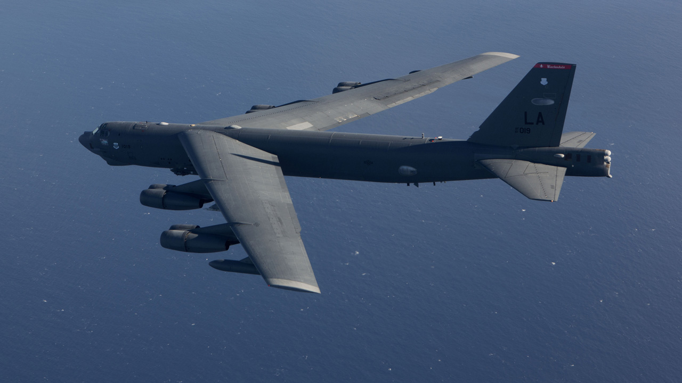
B-52H Bomber

Slide 16
Shield Termination: RD - OTA Robins AFB – 410 SCMS
MD: | B-52
TMS: | N/A
Noun: | Shield Termination
NSN: | 5935-01-569-0558
P/N: | F659-32664-2
Buy Price: | $2,140.95
Date Last Procured: | NA
Repair Cost: | NA
AAC: | C
Surplus Available: | 0
QPA/APPL Rate: | 1 | 100%
Replacement Rate:
AMC/AMSC: | NA | NA
RMC/RMSC: | NA | NA
Material: | Not Available
Dimensions: | Not Available
Criticality Code: | X
Drawings Releasable: | No
Drawing #:
T.O. Releasable: | No
T.O. #:
Budget Code: | 8
Drawing Cage Code: | 82918
Next Higher Asmbly: | MUSTANG Tester
Out Year Requirements: BUY
FY23: | 0 | FY24: | 0 | FY25: | 0 | FY26: | 0 | FY27: | 0
Out Year Requirements: REPAIR
FY23: | 1 | FY24: | 1 | FY25: | 1 | FY26: | 1 | FY27: | 1
EDL: | Unavailable |  |  |  |  | RDL: | Unavailable
Tinker | ------ |  |  |  |  | Robins | 3/24/2023
Hill | ------ |  |  |  |  | Virtual | ------
Comments
Deliverables: Complete Technical Data Package (TDP) including all repair processes
Interested vendors should submit a White Paper to 429SCMS.SASPO.workflow@us.af.mil
RSVP for Technical Discussions

Slide 17
Circuit Card Assembly: RD - OTA Robins AFB – 410 SCMS
MD: | B-52
TMS: | N/A
Noun: | Circuit Card Assembly
NSN: | 5998-01-568-3779
P/N: | F659-32559-1
Buy Price: | $13,866.60
Date Last Procured: | NA
Repair Cost: | $4,437.31
AAC: | C
Surplus Available: | 0
QPA/APPL Rate: | 1 | 100%
Replacement Rate:
AMC/AMSC: | NA | NA
RMC/RMSC: | 4 | R
Material: | Not Available
Dimensions: | Not Available
Criticality Code: | X
Drawings Releasable: | No
Drawing #:
T.O. Releasable: | No
T.O. #:
Budget Code: | 8
Drawing Cage Code: | 82918
Next Higher Asmbly: | MUSTANG Tester
Out Year Requirements: BUY
FY23: | 0 | FY24: | 0 | FY25: | 0 | FY26: | 0 | FY27: | 0
Out Year Requirements: REPAIR
FY23: | 1 | FY24: | 1 | FY25: | 1 | FY26: | 1 | FY27: | 1
EDL: | Unavailable |  |  |  |  | RDL: | Unavailable
Tinker | ------ |  |  |  |  | Robins | 3/24/2023
Hill | ------ |  |  |  |  | Virtual | ------
Comments
Deliverables: Complete Technical Data Package (TDP) including all repair processes
Interested vendors should submit a White Paper to 429SCMS.SASPO.workflow@us.af.mil
RSVP for Technical Discussions

Slide 18
Power Supply: RD - OTA Robins AFB – 410 SCMS
MD: | B-52
TMS: | N/A
Noun: | Power Supply
NSN: | 6130-01-109-8291
P/N: | F675-16005-1
Buy Price: | $39,250.01
Date Last Procured: | NA
Repair Cost: | $11,382.50
AAC: | V
Surplus Available: | 0
QPA/APPL Rate: | 2 | 100%
Replacement Rate:
AMC/AMSC: | 3 | R
RMC/RMSC: | 4 | R
Material: | Not Available
Dimensions: | Not Available
Criticality Code: | X
Drawings Releasable: | No
Drawing #:
T.O. Releasable: | No
T.O. #:
Budget Code: | 8
Drawing Cage Code: | 82918
Next Higher Asmbly: | MUSTANG Tester
Out Year Requirements: BUY
FY23: | 0 | FY24: | 0 | FY25: | 0 | FY26: | 0 | FY27: | 0
Out Year Requirements: REPAIR
FY23: | 3 | FY24: | 1 | FY25: | 1 | FY26: | 1 | FY27: | 1
EDL: | Unavailable |  |  |  |  | RDL: | Unavailable
Tinker | ------ |  |  |  |  | Robins | 3/24/2023
Hill | ------ |  |  |  |  | Virtual | ------
Comments
Deliverables: Complete Technical Data Package (TDP) including all repair processes
Interested vendors should submit a White Paper to 429SCMS.SASPO.workflow@us.af.mil
RSVP for Technical Discussions

Slide 19
B-52 MUSTANG Tester: RD - OTA Robins AFB – 410 SCMS
If you would like to participate in the Technical Discussion on:
April 25, 2023
provide the following, NLT
April 14, 2023
429SCMS.SASPO.Workflow@us.af.mil
-Company, -Address, -Name(s), -Email(s), -Phone,
-Your questions for Engineering, and
-Statement of Capabilities

Slide 20
RF Amplifier Subassembly: AS - New Buy Robins AFB – 407 SCMS
MD: | B-52/E-3/E-4B
TMS: | N/A
Noun: | Radio Frequency Amplifier Subassembly
NSN: | 5996-01-060-0234
P/N: | 351-9711-030
Buy Price: | $1,390.00
Date Last Procured: | 2/1/2011
Repair Cost: | N/A
AAC: | V
Surplus Available: | 0
QPA/APPL Rate: | 1 | 100%
Replacement Rate: | 20
AMC/AMSC: | 2 | G
RMC/RMSC: | N/A | N/A
Material: | Not Available
Dimensions: | Not Available
Criticality Code: | X
Drawings Releasable: | Yes
Drawing #: | 351-9711
T.O. Releasable: | No
T.O. #: | NA
Budget Code: | 9
Drawing Cage Code: | 13499
Next Higher Asmbly: | Radio Frequency Amplifier/5996010428037
Out Year Requirements: BUY
FY23: | 9 | FY24: | 9 | FY25: | 9 | FY26: | 9 | FY27: | 9
Out Year Requirements: REPAIR
FY23: | 0 | FY24: | 0 | FY25: | 0 | FY26: | 0 | FY27: | 0
EDL: | Available |  |  |  |  | RDL: | Not Available
Tinker | ------ |  |  |  |  | Robins | 3/24/2023
Hill | ------ |  |  |  |  | Virtual | ------
Comments
No longer procurable by DLA
Deliverables: Source Approval Request (SAR) Package. Please send a request to randy.miller.22@us.af.mil and include your email address and “request a drop off”. A “request for drop off” will be returned, use this to submit your SAR package.
NOTE: Send notification to 429SCMS.SASPO.Workflow@us.af.mil within 45 days of intent to submit SAR package.

Slide 21
RF Amplifier Subassembly: AS - New Buy Robins AFB – 407 SCMS
MD: | B-52/E-3/E-4B
TMS: | N/A
Noun: | Radio Frequency Amplifier Subassembly
NSN: | 5996-01-060-0235
P/N: | 351-9715-010
Buy Price: | $4,445.00
Date Last Procured: | 6/1/1995
Repair Cost: | N/A
AAC: | V
Surplus Available: | 0
QPA/APPL Rate: | 1 | 100%
Replacement Rate: | 48
AMC/AMSC: | 3 | D
RMC/RMSC: | N/A | N/A
Material: | Not Available
Dimensions: | Not Available
Criticality Code: | X
Drawings Releasable: | Yes
Drawing #: | 351-9715
T.O. Releasable: | No
T.O. #: | NA
Budget Code: | 9
Drawing Cage Code: | 13499
Next Higher Asmbly: | Radio Frequency Amplifier/5996010428037
Out Year Requirements: BUY
FY23: | 5 | FY24: | 5 | FY25: | 5 | FY26: | 5 | FY27: | 5
Out Year Requirements: REPAIR
FY23: | 0 | FY24: | 0 | FY25: | 0 | FY26: | 0 | FY27: | 0
EDL: | Available |  |  |  |  | RDL: | Not Available
Tinker | ------ |  |  |  |  | Robins | 3/24/2023
Hill | ------ |  |  |  |  | Virtual | ------
Comments
No longer procurable by DLA
Deliverables: Source Approval Request (SAR) Package. Please send a request to randy.miller.22@us.af.mil and include your email address and “request a drop off”. A “request for drop off” will be returned, use this to submit your SAR package.
NOTE: Send notification to 429SCMS.SASPO.Workflow@us.af.mil within 45 days of intent to submit SAR package.

Slide 22
Retaining Ring: AS – New Buy Tinker AFB – LCMC
MD: | B-52, C-135, E-8
TMS: | TF33-P-102C, TF33-P-103, TF33-P-5, TF33-P-9
Noun: | Retaining Ring
NSN: | 5325-00-802-6799
P/N: | 386443
Buy Price: | $7.00
Date Last Procured: | 07/01/2022
Repair Cost: | $0.00
AAC: | D
Surplus Available: | 0
QPA/APPL Rate: | 1 | 100%
Replacement Rate:
AMC/AMSC: | 2 | C
RMC/RMSC: | N/A | N/A
Material: | AMS 5120 Steel
Dimensions: | 2.980" OD; 0.071" Minor Thickness; 0.093" Major Thickness
Criticality Code: | F
Drawings Releasable: | Yes
Drawing #: | 386443
T.O. Releasable: | Yes
T.O. #: | 2J-TF33-4/-34
Budget Code: | 9
Drawing Cage Code: | 77445
Next Higher Asmbly: | Gear Box
Out Year Requirements: BUY
FY23: | 44 | FY24: | 22 | FY25: | 44 | FY26: | 22 | FY27: | 0
Out Year Requirements: REPAIR
FY23: | 0 | FY24: | 0 | FY25: | 0 | FY26: | 0 | FY27: | 0
EDL: | Available |  |  |  |  | RDL: | Unavailable
Tinker | ------ |  |  |  |  | Robins | 3/24/2023
Hill | ------ |  |  |  |  | Virtual | ------
Comments
Deliverables: Source Approval Request (SAR) Package.
Interested vendors should submit a Source Approval Request (SAR) to dlaavnsmallbus@dla.mil
NOTE: Send notification to 429SCMS.SASPO.Workflow@us.af.mil within 45 days of intent to submit SAR package.

Slide 23
Oil Tank Cushion: AS – New Buy Tinker AFB – LCMC
MD: | B-52
TMS: | TF33-PW-103
Noun: | Oil Tank Cushion
NSN: | 2840-00-787-7803
P/N: | 415750
Buy Price: | $963.78
Date Last Procured: | 2/1/2018
Repair Cost: | $
AAC: | Z
Surplus Available: | 0
QPA/APPL Rate: | 2 | %100
Replacement Rate: | %
AMC/AMSC: | 1 | C
RMC/RMSC: | NA | NA
Material:
Dimensions:
Criticality Code: | Y
Drawings Releasable: | Yes
Drawing #: | 415750
T.O. Releasable: | Yes
T.O. #: | 2J-TF33-4
Budget Code: | 9
Drawing Cage Code: | 77445
Next Higher Asmbly: | Oil Tank Assembly
Out Year Requirements: BUY
FY23: | 84 | FY24: | 76 | FY25: | 84 | FY26: | 76 | FY27: | 21
Out Year Requirements: REPAIR
FY23: | 0 | FY24: | 0 | FY25: | 0 | FY26: | 0 | FY27: | 0
EDL: | Available |  |  |  |  | RDL: | Unavailable
Tinker | ------ |  |  |  |  | Robins | 3/24/2023
Hill | ------ |  |  |  |  | Virtual | ------
Comments
Deliverables: Source Approval Request (SAR) Package.
Interested vendors should submit a Source Approval Request (SAR) to dlaavnsmallbus@dla.mil.
NOTE: Send notification to 429SCMS.SASPO.Workflow@us.af.mil within 45 days of intent to submit SAR package.

Slide 24
Counterbalance Weight: AS – New Buy Tinker AFB – LCMC
MD: | B-52, OC-135B, WC-135C/W, E-3
TMS: | TF33-P-103, TF33-P-5, TF33-P-9, TF33-PW-100A
Noun: | Counterbalance Weight
NSN: | 3040-00-983-1153
P/N: | 461035CL6
Buy Price: | $7.22
Date Last Procured: | 1/1/2019
Repair Cost: | N/A
AAC: | D
Surplus Available: | 7859
QPA/APPL Rate: | 1 | 100%
Replacement Rate: | 10
AMC/AMSC: | 1 | C
RMC/RMSC: | N/A | N/A
Material: | AMS 5613 SST
Dimensions: | 0.375 IN DIA - 0.3125-24 UNF-28
Criticality Code: | Y
Drawings Releasable: | Yes
Drawing #: | 461035
T.O. Releasable: | Yes
T.O. #: | 2J-TF33-4/-44
Budget Code: | 9
Drawing Cage Code: | 77445
Next Higher Asmbly: | LS Turb
Out Year Requirements: BUY
FY23: | 242 | FY24: | 241 | FY25: | 241 | FY26: | 483 | FY27: | 0
Out Year Requirements: REPAIR
FY23: | 0 | FY24: | 0 | FY25: | 0 | FY26: | 0 | FY27: | 0
EDL: | Available |  |  |  |  | RDL: | Unavailable
Tinker | ----- |  |  |  |  | Robins | 3/24/2023
Hill | ----- |  |  |  |  | Virtual | ------
Comments
Deliverables: Source Approval Request (SAR) Package.
Interested vendors should submit a Source Approval Request (SAR) to dlaavnsmallbus@dla.mil
NOTE: Send notification to 429SCMS.SASPO.Workflow@us.af.mil within 45 days of intent to submit SAR package.

Slide 25
Compressor Baffle: AS – New Buy Tinker AFB – LCMC
MD: | B-52
TMS: | TF33-PW-100A
Noun: | Compressor Baffle
NSN: | 4820-00-348-8796
P/N: | 286958
Buy Price: | $539.18
Date Last Procured: | 01/03/2023
Repair Cost: | $0.00
AAC: | Z
Surplus Available: | 0
QPA/APPL Rate: | 1 | 100%
Replacement Rate:
AMC/AMSC: | 2 | C
RMC/RMSC: | N/A | N/A
Material: | Steel
Dimensions:
Criticality Code: | X
Drawings Releasable: | Yes
Drawing #: | 286958
T.O. Releasable: | Yes
T.O. #: | 9P5-17-1-113
Budget Code: | 9
Drawing Cage Code: | 77445
Next Higher Asmbly: | Compressor Bleed Valve
Out Year Requirements: BUY
FY23: | 25 | FY24: | 50 | FY25: | 35 | FY26: | 52 | FY27: | 0
Out Year Requirements: REPAIR
FY23: | 0 | FY24: | 0 | FY25: | 0 | FY26: | 0 | FY27: | 0
EDL: | Available |  |  |  |  | RDL: | Unavailable
Tinker | ------ |  |  |  |  | Robins | 3/24/2023
Hill | ------ |  |  |  |  | Virtual | ------
Comments
Deliverables: Source Approval Request (SAR) Package.
Interested vendors should submit a Source Approval Request (SAR) to dlaavnsmallbus@dla.mil
NOTE: Send notification to 429SCMS.SASPO.Workflow@us.af.mil within 45 days of intent to submit SAR package.

Slide 26
Seat Valve: AS – New Buy Tinker AFB – LCMC
MD: | B-52
TMS: | TF33-PW-103
Noun: | Seat-Valve, Oil Filter Check
NSN: | 4820-01-202-6339
P/N: | 755936
Buy Price: | $497.70
Date Last Procured: | 7/1/2018
Repair Cost: | $
AAC: | Z
Surplus Available: | 0
QPA/APPL Rate: | 1 | 100%
Replacement Rate: | %
AMC/AMSC: | 1 | C
RMC/RMSC: | NA | NA
Material: | Corrosion Resistant Steel
Dimensions: | 2.95 In X 2.496 In
Criticality Code: | X
Drawings Releasable: | Yes
Drawing #: | 755936
T.O. Releasable: | Yes
T.O. #: | 2J-TF33-4
Budget Code: | 9
Drawing Cage Code: | 77445
Next Higher Asmbly: | Oil Filter Assembly
Out Year Requirements: BUY
FY23: | 0 | FY24: | 11 | FY25: | 0 | FY26: | 0 | FY27: | 0
Out Year Requirements: REPAIR
FY23: | 0 | FY24: | 0 | FY25: | 0 | FY26: | 0 | FY27: | 0
EDL: | Unavailable |  |  |  |  | RDL: | Unavailable
Tinker | ------ |  |  |  |  | Robins | 3/24/2023
Hill | ------ |  |  |  |  | Virtual | ------
Comments
Deliverables: Source Approval Request (SAR) Package.
Interested vendors should submit a Source Approval Request (SAR) to dlaavnsmallbus@dla.mil.
NOTE: Send notification to 429SCMS.SASPO.Workflow@us.af.mil within 45 days of intent to submit SAR package.

Slide 27
Shouldered Washer: AS – New Buy Tinker AFB – LCMC
MD: | B-52/C-135/E-8
TMS: | TF33-P-5, TF33-P-9, TF33-P-102C, TF33-P-103
Noun: | Shouldered Washer
NSN: | 5310-00-164-1100
P/N: | 579856
Buy Price: | $20.55
Date Last Procured: | 3/1/2002
Repair Cost: | N/A
AAC: | Z
Surplus Available: | 222
QPA/APPL Rate: | 2 | 100%
Replacement Rate: | 12
AMC/AMSC: | 1 | C
RMC/RMSC: | N/A | N/A
Material: | AMS 6322 STL
Dimensions: | 0.276 IN Min/0.286 IN Max Hole Dia; 0.61 IN Min/0.63 IN Max OD
Criticality Code: | X
Drawings Releasable: | Yes
Drawing #: | 579856
T.O. Releasable: | Yes
T.O. #: | 2J-TF33-4/-34
Budget Code: | 9
Drawing Cage Code: | 77445
Next Higher Asmbly: | Gear Box
Out Year Requirements: BUY
FY23: | 98 | FY24: | 99 | FY25: | 98 | FY26: | 99 | FY27: | 24
Out Year Requirements: REPAIR
FY23: | 0 | FY24: | 0 | FY25: | 0 | FY26: | 0 | FY27: | 0
EDL: | Unavailable |  |  |  |  | RDL: | Unavailable
Tinker | ----- |  |  |  |  | Robins | 3/24/2023
Hill | ----- |  |  |  |  | Virtual | ------
Comments
Deliverables: Source Approval Request (SAR) Package.
Interested vendors should submit a Source Approval Request (SAR) to dlaavnsmallbus@dla.mil
NOTE: Send notification to 429SCMS.SASPO.Workflow@us.af.mil within 45 days of intent to submit SAR package.

Slide 28
Metal Seal Ring: AS – New Buy Tinker AFB – LCMC
MD: | B-52/C-135/E-3/E-8
TMS: | TF33-P-102C, TF33-P-103, TF33-P-5, TF33-P-9, TF33-P-100A
Noun: | Metal Seal Ring
NSN: | 5330-00-992-1516
P/N: | 481314
Buy Price: | $153.75
Date Last Procured: | 03/01/2015
Repair Cost: | $0.00
AAC: | D
Surplus Available: | 0
QPA/APPL Rate: | 1 | 100%
Replacement Rate: | 87%
AMC/AMSC: | 1 | C
RMC/RMSC: | N/A | N/A
Material: | Steel
Dimensions: | 2.125" Min/2.127" Max OD; 0.135" Min/0.145" Max Rad Wall Thickness; 0.07" Min/0.072" Max W
Criticality Code: | X
Drawings Releasable: | Yes
Drawing #: | 481314
T.O. Releasable: | Yes
T.O. #: | 2J-TF33-4/-34/-44
Budget Code: | 9
Drawing Cage Code: | 77445
Next Higher Asmbly: | Anti-Icing Valve Assembly
Out Year Requirements: BUY
FY23: | 86 | FY24: | 94 | FY25: | 70 | FY26: | 93 | FY27: | 0
Out Year Requirements: REPAIR
FY23: | 0 | FY24: | 0 | FY25: | 0 | FY26: | 0 | FY27: | 0
EDL: | Unavailable |  |  |  |  | RDL: | Unavailable
Tinker | ------ |  |  |  |  | Robins | 3/24/2023
Hill | ------ |  |  |  |  | Virtual | ------
Comments
Deliverables: Source Approval Request (SAR) Package.
Interested vendors should submit a Source Approval Request (SAR) to dlaavnsmallbus@dla.mil
NOTE: Send notification to 429SCMS.SASPO.Workflow@us.af.mil within 45 days of intent to submit SAR package.

Slide 29
O-Ring: AS – New Buy Tinker AFB – LCMC
MD: | B-52, OC-135B, WC-135C/W, E-3
TMS: | TF33-P-103, TF33-P-5, TF33-P-9, TF33-PW-100A
Noun: | O-Ring
NSN: | 5331-01-010-2929
P/N: | ST1050-158
Buy Price: | $1.33
Date Last Procured: | 7/1/2011
Repair Cost: | N/A
AAC: | Z
Surplus Available: | 5
QPA/APPL Rate: | 1 | 100%
Replacement Rate: | 57
AMC/AMSC: | 1 | G
RMC/RMSC: | N/A | N/A
Material: | AMS 7276 Fluorocarbon Rubber
Dimensions: | Center Hole Dia 4-722 IN Min X 4.752 IN Max; Cross Sect. Height 0.100 IN Min X 0.106 IN Max
Criticality Code: | X
Drawings Releasable: | Yes
Drawing #: | ST1050
T.O. Releasable: | Yes
T.O. #: | 2J-TF33-4/-44
Budget Code: | 9
Drawing Cage Code: | 77445
Next Higher Asmbly: | Gear Box
Out Year Requirements: BUY
FY23: | 0 | FY24: | 603 | FY25: | 0 | FY26: | 0 | FY27: | 0
Out Year Requirements: REPAIR
FY23: | 0 | FY24: | 0 | FY25: | 0 | FY26: | 0 | FY27: | 0
EDL: | Unavailable |  |  |  |  | RDL: | Unavailable
Tinker | ----- |  |  |  |  | Robins | 3/24/2023
Hill | ----- |  |  |  |  | Virtual | ------
Comments
Interested vendors should query SAM.gov for future opportunities

Slide 30
Nut Locking Plate: AS – New Buy Tinker AFB – LCMC
MD: | B-52, OC-135B, WC-135C/W, E-3
TMS: | TF33-P-103, TF33-P-5, TF33-P-9, TF33-PW-100A
Noun: | Nut Locking Plate
NSN: | 5340-00-510-1243
P/N: | 302901
Buy Price: | $2.92
Date Last Procured: | 3/1/2019
Repair Cost: | N/A
AAC: | Z
Surplus Available: | 4358
QPA/APPL Rate: | 3 | 100%
Replacement Rate: | 1
AMC/AMSC: | 1 | G
RMC/RMSC: | N/A | N/A
Material: | AMS 5504 Stainless Steel
Dimensions: | 0.281 IN ID X 0.845 IN Long
Criticality Code: | X
Drawings Releasable: | Yes
Drawing #: | 302901
T.O. Releasable: | Yes
T.O. #: | 2J-TF33-4/-44
Budget Code: | 9
Drawing Cage Code: | 77445
Next Higher Asmbly: | Turbine Engine Rear Bearing Support
Out Year Requirements: BUY
FY23: | 386 | FY24: | 386 | FY25: | 386 | FY26: | 386 | FY27: | 0
Out Year Requirements: REPAIR
FY23: | 0 | FY24: | 0 | FY25: | 0 | FY26: | 0 | FY27: | 0
EDL: | Unavailable |  |  |  |  | RDL: | Unavailable
Tinker | ----- |  |  |  |  | Robins | 3/24/2023
Hill | ----- |  |  |  |  | Virtual | ------
Comments
Interested vendors should query SAM.gov for future opportunities

Slide 31
Helical Compressor Spring: AS – New Buy Tinker AFB – LCMC
MD: | B-52, OC-135B, WC-135C/W, E-3
TMS: | TF33-P-103, TF33-P-5, TF33-P-9, TF33-PW-100A
Noun: | Helical Compressor Spring
NSN: | 5360-00-663-1118
P/N: | 288569
Buy Price: | $67.54
Date Last Procured: | 1/1/2021
Repair Cost: | N/A
AAC: | V
Surplus Available: | 941
QPA/APPL Rate: | 1 | 100%
Replacement Rate: | 5
AMC/AMSC: | 1 | C
RMC/RMSC: | N/A | N/A
Material: | Stainless Steel AMS 5688
Dimensions: | 1.662 IN OD X 0.172 IN DIA Wire
Criticality Code: | X
Drawings Releasable: | Yes
Drawing #: | 288569
T.O. Releasable: | Yes
T.O. #: | 2J-TF33-4/-44
Budget Code: | 9
Drawing Cage Code: | 77445
Next Higher Asmbly: | Fuel Pressurizing and Dump Valve
Out Year Requirements: BUY
FY23: | 0 | FY24: | 65 | FY25: | 66 | FY26: | 65 | FY27: | 0
Out Year Requirements: REPAIR
FY23: | 0 | FY24: | 0 | FY25: | 0 | FY26: | 0 | FY27: | 0
EDL: | Available |  |  |  |  | RDL: | Unavailable
Tinker | ----- |  |  |  |  | Robins | 3/24/2023
Hill | ----- |  |  |  |  | Virtual | ------
Comments
Deliverables: Source Approval Request (SAR) Package.
Interested vendors should submit a Source Approval Request (SAR) to dlaavnsmallbus@dla.mil
NOTE: Send notification to 429SCMS.SASPO.Workflow@us.af.mil within 45 days of intent to submit SAR package.

Slide 32
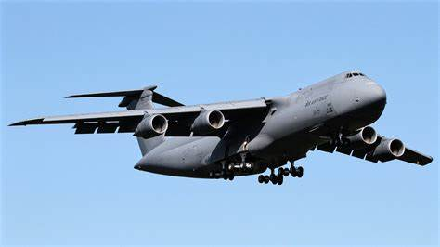
C-5 Galaxy
Supplying Warfighter Dominance

Slide 33
409th SCMS C-5M Shared Avionic Components Overview
409th SCMS POCs:
LMS: Rebecca Lopez
EN: Thomas Amely
SP: Kimberly Collins
ES: Tony Mefford
20230221

Slide 34
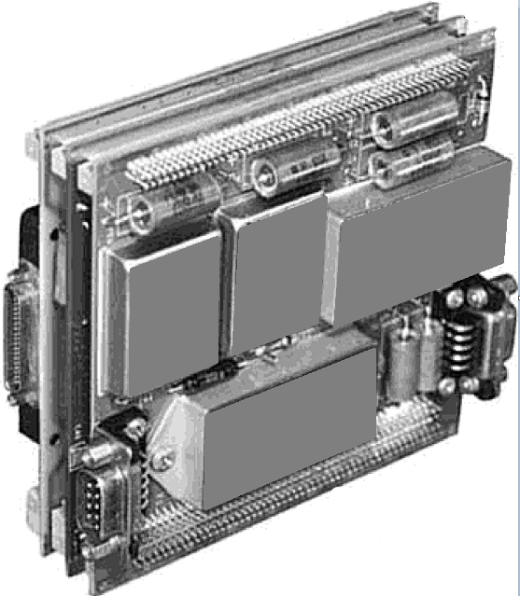
CCA Breakdown
Power Supply CCAs
2 Layer PCB
1x EMI Input Filter and Transient Suppression Module
3x DC-DC Converters
Various Active and Passive Components
Various Connectors
Outer Card Pictured is The PS CCA →

Slide 35
Technical Data
Have: Bill of Material (BOM)
We have what we understand to be the most recent version of the BOM for each card.
Have: Sample Assets
We have assets that can be utilized to develop a technical data package.
Don’t Have: Gerber or Board Files
Files used to reproduce a printed circuit board (PCB)

Slide 36
Desired Outcomes
Level 3 Technical Data Packages
Sufficient for production as defined by MIL-STD-31000B
Updated BOMs, Gerber Files, STP, MODEL, 3DXML, etc.
Prototypes for Testing
QTY TBD
DMSMS Analysis and Solutions Per Board
Environmental Testing Support

Slide 37
Power Supply CCA: RE - OTA Robins AFB – 409 SCMS
MD: | C-5
TMS: | N/A
Noun: | Power Supply Circuit Card Assembly
NSN: | 5998-01-666-0875
P/N: | 4V10446-101A
Buy Price: | $1,887.00
Date Last Procured: | 12/1/2011
Repair Cost: | N/A
AAC: | Z
Surplus Available: | 0
QPA/APPL Rate: | 1 | 100%
Replacement Rate:
AMC/AMSC: | N/A | N/A
RMC/RMSC: | N/A | N/A
Material: | Printed Circuit Board
Dimensions: | 4.564 IN X 4.380 IN X 0.5 IN
Criticality Code: | X
Drawings Releasable: | Yes
Drawing #: | 4V10446 Rev B
T.O. Releasable: | Yes
T.O. #: | 5A13-5-29-3, 5A13-5-30-3
Budget Code: | 9
Drawing Cage Code: | 98897
Next Higher Asmbly: | 4V10435-103A/5998-01-599-8127 - AFCSP GPPI Stack 4V10435-101A/5998-01-600-4999 - CNP GPPI Stack
Out Year Requirements: BUY
FY23: | 21 | FY24: | 21 | FY25: | 21 | FY26: | 21 | FY27: | 21
Out Year Requirements: REPAIR
FY23: | 0 | FY24: | 0 | FY25: | 0 | FY26: | 0 | FY27: | 0
EDL: | Unavailable |  |  |  |  | RDL: | Unavailable
Tinker | ------ |  |  |  |  | Robins | 3/24/2023
Hill | ------ |  |  |  |  | Virtual | ------
Comments
No repair cost/history due to the asset an ERRC N item
Deliverables: Complete Technical Data Package (TDP)
Interested vendors should submit a White Paper to 429SCMS.SASPO.workflow@us.af.mil
RSVP for Technical Discussions

Slide 38
Power Supply CCA: RE - OTA Robins AFB – 409 SCMS
MD: | C-5
TMS: | N/A
Noun: | Power Supply Circuit Card Assembly
NSN: | 6130-01-666-2763
P/N: | 4V10446-103A
Buy Price: | $2,218.50
Date Last Procured: | 12/1/2011
Repair Cost: | N/A
AAC: | J
Surplus Available: | 0
QPA/APPL Rate: | 1 | 100%
Replacement Rate:
AMC/AMSC: | N/A | N/A
RMC/RMSC: | N/A | N/A
Material: | Printed Circuit Board
Dimensions: | 4.564 IN X 4.380 IN X 0.5 IN
Criticality Code: | X
Drawings Releasable: | Yes
Drawing #: | 4V10446 Rev B
T.O. Releasable: | Yes
T.O. #: | 5A13-5-27-3
Budget Code: | 9
Drawing Cage Code: | 98897
Next Higher Asmbly: | 4V10435-105A/5998-01-599-8126 - CCD/CCP GPPI Stack
Out Year Requirements: BUY
FY23: | 21 | FY24: | 21 | FY25: | 21 | FY26: | 21 | FY27: | 21
Out Year Requirements: REPAIR
FY23: | 0 | FY24: | 0 | FY25: | 0 | FY26: | 0 | FY27: | 0
EDL: | Unavailable |  |  |  |  | RDL: | Unavailable
Tinker | ------ |  |  |  |  | Robins | 3/24/2023
Hill | ------ |  |  |  |  | Virtual | ------
Comments
No repair cost/history due to the asset an ERRC N item
Deliverables: Complete Technical Data Package (TDP)
Interested vendors should submit a White Paper to 429SCMS.SASPO.workflow@us.af.mil
RSVP for Technical Discussions

Slide 39
C-5 Circuit Card Assemblies: RE - OTA Robins AFB – 409 SCMS
If you would like to participate in the Technical Discussion on:
April 25, 2023
provide the following, NLT
April 14, 2023
429SCMS.SASPO.Workflow@us.af.mil
-Company, -Address, -Name(s), -Email(s), -Phone,
-Your questions for Engineering, and
-Statement of Capabilities

Slide 40
E-3 AWACS

Slide 41
Counterbalance Weight: AS – New Buy Tinker AFB – LCMC
MD: | E-3
TMS: | TF33-PW-100A
Noun: | Counterbalance Weight
NSN: | 3040-00-442-3631
P/N: | 502281CL1
Buy Price: | $497.70
Date Last Procured: | 8/1/2022
Repair Cost: | $
AAC: | Z
Surplus Available: | 36
QPA/APPL Rate: | 0 | 0
Replacement Rate:
AMC/AMSC: | 3 | C
RMC/RMSC: | NA | NA
Material: | AMS 5613 Stainless Steel
Dimensions: | 0.478-0.488 ID X 0.000-0.086 ID
Criticality Code: | X
Drawings Releasable: | Yes
Drawing #: | 502281
T.O. Releasable: | Yes
T.O. #: | 2J-TF33-4/-34/-44
Budget Code: | 9
Drawing Cage Code: | 77445
Next Higher Asmbly: | HS Comp
Out Year Requirements: BUY
FY23: | 44 | FY24: | 0 | FY25: | 44 | FY26: | 0 | FY27: | 0
Out Year Requirements: REPAIR
FY23: | 0 | FY24: | 0 | FY25: | 0 | FY26: | 0 | FY27: | 0
EDL: | Unavailable |  |  |  |  | RDL: | Unavailable
Tinker | ------ |  |  |  |  | Robins | 3/24/2023
Hill | ------ |  |  |  |  | Virtual | ------
Comments
Deliverables: Source Approval Request (SAR) Package.
Interested vendors should submit a Source Approval Request (SAR) to dlaavnsmallbus@dla.mil.
NOTE: Send notification to 429SCMS.SASPO.Workflow@us.af.mil within 45 days of intent to submit SAR package.

Slide 42
Bearing Sleeve: AS – New Buy Tinker AFB – LCMC
MD: | E-3
TMS: | TF33-PW-100A
Noun: | Bearing Sleeve
NSN: | 3120-00-226-4671
P/N: | 480162
Buy Price: | $146.82
Date Last Procured: | 11/15/2021
Repair Cost: | NA
AAC: | D
Surplus Available: | 29
QPA/APPL Rate: | 0 | 0
Replacement Rate: | 0
AMC/AMSC: | 1 | C
RMC/RMSC: | NA | NA
Material: | Carbon Graphite Overall
Dimensions: | LENGTH 0.3070 IN. MIN. AND 0.3170 IN. MAX. BODY OUTSIDE DIAMETER 0.3850 IN. MIN. AND 0.3860 IN. MAX.
Criticality Code: | X
Drawings Releasable: | Yes
Drawing #: | 480162
T.O. Releasable: | No
T.O. #: | 2J-TF33-4
Budget Code: | 9
Drawing Cage Code: | 77445
Next Higher Asmbly: | Air Accy
Out Year Requirements: BUY
FY23: | 0 | FY24: | 40 | FY25: | 41 | FY26: | 41 | FY27: | 0
Out Year Requirements: REPAIR
FY23: | 0 | FY24: | 0 | FY25: | 0 | FY26: | 0 | FY27: | 0
EDL: | Unavailable |  |  |  |  | RDL: | Unavailable
Tinker | ------ |  |  |  |  | Robins | 3/24/2023
Hill | ------ |  |  |  |  | Virtual | ------
Comments
Deliverables: Source Approval Request (SAR) Package.
Interested vendors should submit a Source Approval Request (SAR) to dlaavnsmallbus@dla.mil.
NOTE: Send notification to 429SCMS.SASPO.Workflow@us.af.mil within 45 days of intent to submit SAR package.

Slide 43
Body Bolt: AS – New Buy Tinker AFB – LCMC
MD: | E-3
TMS: | TF33-PW-100A
Noun: | Externally Relieved Body Bolt
NSN: | 5306-00-807-1442
P/N: | 387377
Buy Price: | $ 11.86
Date Last Procured: | 7/11/2022
Repair Cost: | $
AAC: | Z
Surplus Available: | 0
QPA/APPL Rate: | 10 | % 100
Replacement Rate: | %
AMC/AMSC: | 1 | C
RMC/RMSC: | NA | NA
Material: | AMS 5616 SST
Dimensions: | 0.3125-24 X 3.100 Long
Criticality Code: | X
Drawings Releasable: | Yes
Drawing #: | 387377
T.O. Releasable: | Yes
T.O. #: | 2J-TF33-44
Budget Code: | 9
Drawing Cage Code: | 77445
Next Higher Asmbly: | Exhaust Case Assembly
Out Year Requirements: BUY
FY23: | 514 | FY24: | 484 | FY25: | 483 | FY26: | 484 | FY27: | 483
Out Year Requirements: REPAIR
FY23: | 0 | FY24: | 0 | FY25: | 0 | FY26: | 0 | FY27: | 0
EDL: | Available |  |  |  |  | RDL: | Unavailable
Tinker | ------ |  |  |  |  | Robins | 3/24/2023
Hill | ------ |  |  |  |  | Virtual | ------
Comments
Deliverables: Source Approval Request (SAR) Package.
Interested vendors should submit a Source Approval Request (SAR) to dlaavnsmallbus@dla.mil.
NOTE: Send notification to 429SCMS.SASPO.Workflow@us.af.mil within 45 days of intent to submit SAR package.

Slide 44
Key Washer: AS – New Buy Tinker AFB – LCMC
MD: | E-3
TMS: | TF33-PW-100A
Noun: | Key Washer
NSN: | 5310-00-336-2841
P/N: | 227340
Buy Price: | $ 2.70
Date Last Procured: | 1/10/2019
Repair Cost: | $
AAC: | D
Surplus Available: | 0
QPA/APPL Rate: | 32 | %100
Replacement Rate: | 100%
AMC/AMSC: | 1 | C
RMC/RMSC: | NA | NA
Material: | Steel Comp 410
Dimensions: | 0.740 in OD X 0.568 in L X 0.031 in thick
Criticality Code: | Y
Drawings Releasable: | Yes
Drawing #: | 227340
T.O. Releasable: | Yes
T.O. #: | 2J-TF33-44
Budget Code: | 9
Drawing Cage Code: | 77445
Next Higher Asmbly: | Diffuser Case Assembly
Out Year Requirements: BUY
FY23: | 1843 | FY24: | 5420 | FY25: | 2724 | FY26: | 5422 | FY27: | 0
Out Year Requirements: REPAIR
FY23: | 0 | FY24: | 0 | FY25: | 0 | FY26: | 0 | FY27: | 0
EDL: | Available |  |  |  |  | RDL: | Unavailable
Tinker | ------ |  |  |  |  | Robins | 3/24/2023
Hill | ------ |  |  |  |  | Virtual | ------
Comments
Deliverables: Source Approval Request (SAR) Package.
Interested vendors should submit a Source Approval Request (SAR) to dlaavnsmallbus@dla.mil.
NOTE: Send notification to 429SCMS.SASPO.Workflow@us.af.mil within 45 days of intent to submit SAR package.

Slide 45
Key Washer: AS – New Buy Tinker AFB – LCMC
MD: | E3
TMS: | TF33-PW-100A
Noun: | Key Washer
NSN: | 5310-00-766-4243
P/N: | 387330
Buy Price: | $1.67
Date Last Procured: | 1/17/2019
Repair Cost: | NA
AAC: | Z
Surplus Available: | 708
QPA/APPL Rate: | 0 | 0
Replacement Rate: | 0
AMC/AMSC: | 1 | G
RMC/RMSC: | NA | NA
Material: | Steel Comp 304L
Dimensions: | Hole Dis. 0.590" min - 0.600" max; OD 0.900" min - 0.920" max
Criticality Code: | X
Drawings Releasable: | Yes
Drawing #: | 387330
T.O. Releasable: | Yes
T.O. #: | 2J-TF33-4/-34
Budget Code: | 9
Drawing Cage Code: | 77445
Next Higher Asmbly: | Turbine Rotor Assembly
Out Year Requirements: BUY
FY23: | 0 | FY24: | 40 | FY25: | 41 | FY26: | 41 | FY27: | 0
Out Year Requirements: REPAIR
FY23: | 0 | FY24: | 0 | FY25: | 0 | FY26: | 0 | FY27: | 0
EDL: | Unavailable |  |  |  |  | RDL: | Unavailable
Tinker | ------ |  |  |  |  | Robins | 3/24/2023
Hill | ------ |  |  |  |  | Virtual | ------
Comments
Interested vendors should query SAM.gov for future opportunities

Slide 46
O-Ring: AS – New Buy Tinker AFB – LCMC
MD: | E-3
TMS: | TF33-PW-100A
Noun: | O-Ring
NSN: | 5331-00-425-9124
P/N: | ST1051-08
Buy Price: | $0.30
Date Last Procured: | 10/1/2014
Repair Cost: | N/A
AAC: | Z
Surplus Available: | 84
QPA/APPL Rate: | 5 | 100%
Replacement Rate: | 8
AMC/AMSC: | 1 | G
RMC/RMSC: | N/A | N/A
Material: | AMS 7276 Fluorocarbon Rubber
Dimensions: | 0.664 IN ID X 0.087 IN DIA Round
Criticality Code: | X
Drawings Releasable: | Yes
Drawing #: | ST1051
T.O. Releasable: | Yes
T.O. #: | 2J-TF33-44
Budget Code: | 9
Drawing Cage Code: | 77445
Next Higher Asmbly: | Main Gear Box
Out Year Requirements: BUY
FY23: | 2778 | FY24: | 0 | FY25: | 0 | FY26: | 0 | FY27: | 0
Out Year Requirements: REPAIR
FY23: | 0 | FY24: | 0 | FY25: | 0 | FY26: | 0 | FY27: | 0
EDL: | Unavailable |  |  |  |  | RDL: | Unavailable
Tinker | ----- |  |  |  |  | Robins | 3/24/2023
Hill | ----- |  |  |  |  | Virtual | ------
Comments
Interested vendors should query SAM.gov for future opportunities

Slide 47
Machine Bolt: AS – New Buy Tinker AFB – 421st SCMS
MD: | E-3
TMS: | TF33-PW-100A
Noun: | Machine Bolt
NSN: | 5306-01-354-0200
P/N: | MS9148-12
Buy Price: | $4.13
Date Last Procured: | 12/24/2015
Repair Cost: | $0.00
AAC: | Z
Surplus Available: | 115
QPA/APPL Rate: | 0 | 0
Replacement Rate: | 0
AMC/AMSC: | 1 | G
RMC/RMSC: | NA | NA
Material: | Steel Comp 8740 Overall
Dimensions: | Length-0.990 IN. MIN. AND 1.010 IN. MAX. Diameter-0.312 IN.
Criticality Code:
Drawings Available:
Drawing #:
T.O. Available: | No
T.O. #: | 2J-TF33-4/-44
Budget Code: | 9
Drawing Cage Code: | 96906
Next Higher Asmbly: | Gas Turbine Engine Compressor
Out Year Requirements: BUY
FY23: | 78 | FY24: | 72 | FY25: | 72 | FY26: | 72 | FY27: | 72
Out Year Requirements: REPAIR
FY23: | 0 | FY24: | 0 | FY25: | 0 | FY26: | 0 | FY27: | 0
EDL: | Unavailable |  |  |  |  | RDL: | Unavailable
Tinker | ----- |  |  |  |  | Robins | 03/24/2023
Hill | ----- |  |  |  |  | Virtual | ------
Comments
Interested vendors should query SAM.gov for future opportunities

Slide 48
O-Ring: AS – New Buy Tinker AFB – LCMC
MD: | E-3
TMS: | TF33-PW-100A
Noun: | O-Ring
NSN: | 5331-00-618-3447
P/N: | AS3578-008
Buy Price: | $0.17
Date Last Procured: | 10/1/2014
Repair Cost: | $
AAC: | D
Surplus Available: | 1356
QPA/APPL Rate: | 1 | 100
Replacement Rate: | 100
AMC/AMSC: | 2 | G
RMC/RMSC: | NA | NA
Material: | Rubber Butadiene-Acrylonitrile Class NBR
Dimensions: | OD-0.305 IN MIN AND 0.327 IN MAX CTR Hole Dia. 0.171 IN MIN AND 0.181 IN MAX Cross Sect. Hgt 0.067 IN MIN AND 0.073 IN MAX
Criticality Code: | X
Drawings Releasable:
Drawing #:
T.O. Releasable: | Yes
T.O. #: | 2J-TF33-44
Budget Code: | 9
Drawing Cage Code:
Next Higher Asmbly: | Fuel Filter Assembly
Out Year Requirements: BUY
FY23: | 5000 | FY24: | 0 | FY25: | 0 | FY26: | 0 | FY27: | 0
Out Year Requirements: REPAIR
FY23: | 0 | FY24: | 0 | FY25: | 0 | FY26: | 0 | FY27: | 0
EDL: | Unavailable |  |  |  |  | RDL: | Unavailable
Tinker | ------ |  |  |  |  | Robins | 3/24/2023
Hill | ------ |  |  |  |  | Virtual | ------
Comments
Interested vendors should query SAM.gov for future opportunities

Slide 49
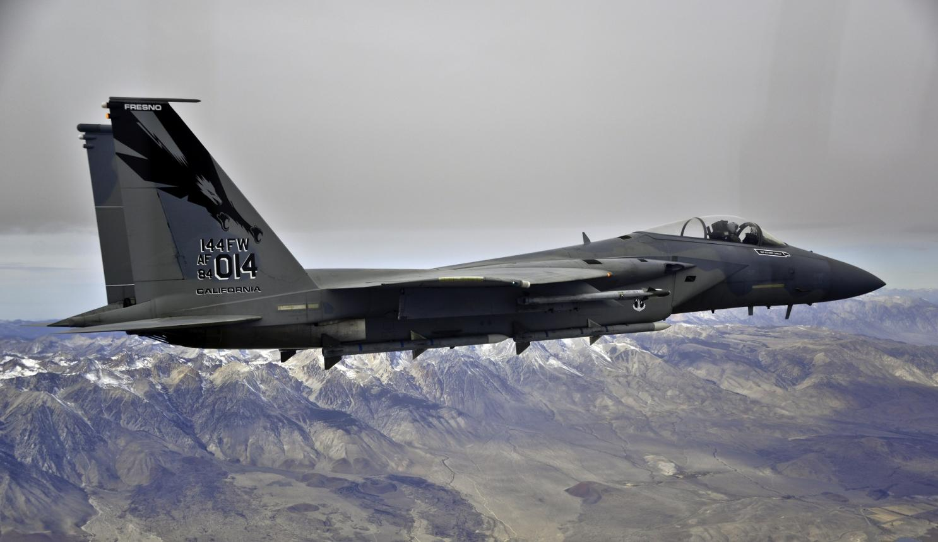
F-15 Eagle

Slide 50
I/O Interface CCA: AS - Repair Robins AFB – 410 SCMS
MD: | F-15
TMS: | N/A
Noun: | Input/Output Interface Circuit Card Assembly
NSN: | 5998-01-330-7909
P/N: | A06G2884-2
Buy Price: | $8,307.12
Date Last Procured: | 3/19/1991
Repair Cost: | $4,616.00
AAC: | V
Surplus Available: | 0
QPA/APPL Rate: | 1 | 100%
Replacement Rate:
AMC/AMSC: | NA | NA
RMC/RMSC: | 5 | N
Material: | Not Available
Dimensions: | 18.5 IN L X 12.5 IN W X 3 IN H X 5.3 LBS
Criticality Code: | Y
Drawings Available: | Yes
Drawing #: | A06G2884
T.O. Available: | Yes
T.O. #: | 33A1-5-531-4/33A1-5-531-1
Budget Code: | 8
Drawing Cage Code: | 12464
Next Higher Asmbly: | F-15 METS
Out Year Requirements: BUY
FY23: | 0 | FY24: | 0 | FY25: | 0 | FY26: | 0 | FY27: | 0
Out Year Requirements: REPAIR
FY23: | 2 | FY24: | 2 | FY25: | 1 | FY26: | 1 | FY27: | 1
EDL: | Unavailable |  |  |  |  | RDL: | Available
Tinker | ------ |  |  |  |  | Robins | 3/24/2023
Hill | 12/8/2022 |  |  |  |  | Virtual | ------
Comments
Provides an individual parallel I/O controller for each PIU that requires program control in the tester.
Deliverables: Source Approval Request (SAR) Package. Please send a request to randy.miller.22@us.af.mil and include your email address and “request a drop off”. A “request for drop off” will be returned, use this to submit your SAR package.
NOTE: Send notification to 429SCMS.SASPO.Workflow@us.af.mil within 45 days of intent to submit SAR package.

Slide 51
Nozzle Segment, Divergent: RFI-Repair Tinker AFB – 421 SCMS
MD: | F15
TMS: | F100-PW-229
Noun: | Nozzle Segment, Divergent
NSN: | 2840-01-308-4465
P/N: | 4071142
Buy Price:
Date Last Procured:
Repair Cost: | $1736.00
AAC: | C
Surplus Available:
QPA/APPL Rate: | 15 | 100
Replacement Rate:
AMC/AMSC: | 1 | C
RMC/RMSC: | R3 | C
Material:
Dimensions:
Criticality Code: | F
Drawings Releasable: | N/A
Drawing #: | N/A
T.O. Releasable: | Yes
T.O. #: | 2J-F100-53-10
Budget Code: | 8
Drawing Cage Code: | 77445
Next Higher Asmbly: | Augmentor Assy
Out Year Requirements: BUY
FY23: | 0 | FY24: | 0 | FY25: | 0 | FY26: | 0 | FY27: | 0
Out Year Requirements: REPAIR
FY23: | 348 | FY24: | 0 | FY25: | 0 | FY26: | 0 | FY27: | 0
EDL: | N/A |  |  |  |  | RDL: | Available
Tinker | ------ |  |  |  |  | Robins | 03/24/2023
Hill | ------ |  |  |  |  | Virtual | ------
Comments
Looking to see if industry can repair this item and if so, what the repairs consist of, and costs associated with those repairs. Interested vendors please send this information to 429SCMS.SASPO.Workflow@us.af.mil

Slide 52
Nozzle Segment, Balance: RFI-Repair Tinker AFB – 424 SCMS
MD: | F15
TMS: | F100-PW-229
Noun: | Nozzle Segment, Balance
NSN: | 2840-01-308-4466
P/N: | 4070067
Buy Price:
Date Last Procured:
Repair Cost: | $1705.00
AAC: | C
Surplus Available: | No
QPA/APPL Rate: | 15 | 100
Replacement Rate:
AMC/AMSC: | 1 | C
RMC/RMSC: | R1 | C
Material:
Dimensions:
Criticality Code: | F
Drawings Releasable: | N/A
Drawing #: | N/A
T.O. Releasable: | Yes
T.O. #: | 2J-F100-53-10
Budget Code: | 8
Drawing Cage Code: | 77445
Next Higher Asmbly: | Augmentor Assy
Out Year Requirements: BUY
FY23: | 0 | FY24: | 0 | FY25: | 0 | FY26: | 0 | FY27: | 0
Out Year Requirements: REPAIR
FY23: | 220 | FY24: | 0 | FY25: | 0 | FY26: | 0 | FY27: | 0
EDL: | N/A |  |  |  |  | RDL: | Available
Tinker | ------ |  |  |  |  | Robins | 03/24/2023
Hill | ------ |  |  |  |  | Virtual | ------
Comments
Looking to see if industry can repair this item and if so, what the repairs consist of, and costs associated with those repairs. Interested vendors please send this information to 429SCMS.SASPO.Workflow@us.af.mil

Slide 53
Nozzle Segment, Balance: RFI-Repair Tinker AFB – 421 SCMS
MD: | F15
TMS: | F100-PW-220
Noun: | Nozzle Segment, Balance
NSN: | 2840-01-454-8449
P/N: | 4082989
Buy Price:
Date Last Procured:
Repair Cost: | $2249.00
AAC: | C
Surplus Available: | No
QPA/APPL Rate: | 15 | 100
Replacement Rate:
AMC/AMSC: | 1 | C
RMC/RMSC: | R1 | C
Material:
Dimensions:
Criticality Code: | F
Drawings Releasable: | N/A
Drawing #: | N/A
T.O. Releasable: | Yes
T.O. #: | 2J-F100-13-10
Budget Code: | 8
Drawing Cage Code: | 77445
Next Higher Asmbly: | Augmentor Assy
Out Year Requirements: BUY
FY23: | 0 | FY24: | 0 | FY25: | 0 | FY26: | 0 | FY27: | 0
Out Year Requirements: REPAIR
FY23: | 468 | FY24: | 0 | FY25: | 0 | FY26: | 0 | FY27: | 0
EDL: | N/A |  |  |  |  | RDL: | Available
Tinker | ------ |  |  |  |  | Robins | 03/24/2023
Hill | ------ |  |  |  |  | Virtual | ------
Comments
Looking to see if industry can repair this item and if so, what the repairs consist of, and costs associated with those repairs. Interested vendors please send this information to 429SCMS.SASPO.Workflow@us.af.mil

Slide 54
Convergent Nozzle Segment: RFI-Repair Tinker AFB – 421 SCMS
MD: | F15
TMS: | F100-PW-220
Noun: | Convergent Nozzle Segment
NSN: | 2840-01-455-9142
P/N: | 4088060
Buy Price:
Date Last Procured:
Repair Cost: | $1003.00
AAC: | C
Surplus Available: | No
QPA/APPL Rate: | 15 | 100
Replacement Rate:
AMC/AMSC: | 1 | C
RMC/RMSC: | R1 | C
Material:
Dimensions:
Criticality Code: | F
Drawings Releasable: | N/A
Drawing #: | N/A
T.O. Releasable: | Yes
T.O. #: | 2J-F100-13-10
Budget Code: | 8
Drawing Cage Code: | 77445
Next Higher Asmbly: | Augmentor Assy
Out Year Requirements: BUY
FY23: | 0 | FY24: | 0 | FY25: | 0 | FY26: | 0 | FY27: | 0
Out Year Requirements: REPAIR
FY23: | 468 | FY24: | 0 | FY25: | 0 | FY26: | 0 | FY27: | 0
EDL: | N/A |  |  |  |  | RDL: | Available
Tinker | ------ |  |  |  |  | Robins | 03/24/2023
Hill | ------ |  |  |  |  | Virtual | ------
Comments
Looking to see if industry can repair this item and if so, what the repairs consist of, and costs associated with those repairs. Interested vendors please send this information to 429SCMS.SASPO.Workflow@us.af.mil

Slide 55
Nozzle Segment, Divergent: RFI-Repair Tinker AFB – 421 SCMS
MD: | F15
TMS: | F100-PW-220
Noun: | Nozzle Segment, Divergent
NSN: | 2840-01-455-9504
P/N: | 4082986
Buy Price:
Date Last Procured:
Repair Cost: | $1151.00
AAC: | C
Surplus Available: | No
QPA/APPL Rate: | 15 | 100
Replacement Rate:
AMC/AMSC: | 1 | C
RMC/RMSC: | R3 | C
Material:
Dimensions:
Criticality Code: | F
Drawings Releasable: | N/A
Drawing #: | N/A
T.O. Releasable: | Yes
T.O. #: | 2J-F100-13-10
Budget Code: | 8
Drawing Cage Code: | 77445
Next Higher Asmbly: | Augmentor Assy
Out Year Requirements: BUY
FY23: | 0 | FY24: | 0 | FY25: | 0 | FY26: | 0 | FY27: | 0
Out Year Requirements: REPAIR
FY23: | 536 | FY24: | 0 | FY25: | 0 | FY26: | 0 | FY27: | 0
EDL: | N/A |  |  |  |  | RDL: | Available
Tinker | ------ |  |  |  |  | Robins | 3/24/2023
Hill | ------ |  |  |  |  | Virtual | ------
Comments
Looking to see if industry can repair this item and if so, what the repairs consist of, and costs associated with those repairs. Interested vendors please send this information to 429SCMS.SASPO.Workflow@us.af.mil

Slide 56
Nozzle Assy, Convergent : RFI-Repair Tinker AFB – 421 SCMS
MD: | F15
TMS: | 2J-F100-229
Noun: | Convergent Nozzle Assy
NSN: | 2840-01-308-4468
P/N: | 4070741
Buy Price:
Date Last Procured:
Repair Cost: | $2204.00
AAC: | C
Surplus Available: | No
QPA/APPL Rate: | 15 | 100
Replacement Rate:
AMC/AMSC: | 1 | C
RMC/RMSC: | R1 | C
Material:
Dimensions:
Criticality Code: | F
Drawings Releasable: | N/A
Drawing #: | N/A
T.O. Releasable: | Yes
T.O. #: | 2J-TF33-53-10
Budget Code: | 8
Drawing Cage Code: | 77445
Next Higher Asmbly: | Augmentor Assy
Out Year Requirements: BUY
FY23: | 0 | FY24: | 0 | FY25: | 0 | FY26: | 0 | FY27: | 0
Out Year Requirements: REPAIR
FY23: | 164 | FY24: | 0 | FY25: | 0 | FY26: | 0 | FY27: | 0
EDL: | N/A |  |  |  |  | RDL: | Available
Tinker | ------ |  |  |  |  | Robins | 03/24/2023
Hill | ------ |  |  |  |  | Virtual | ------
Comments
Looking to see if industry can repair this item and if so, what the repairs consist of, and costs associated with those repairs. Interested vendors please send this information to 429SCMS.SASPO.Workflow@us.af.mil

Slide 57
Liner Assy, Augmentor: RFI-Repair Tinker AFB – 421 SCMS
MD: | F15
TMS: | F100-PW-220
Noun: | Liner Assy, Augmentor Combustion Chamber
NSN: | 2840-01-443-4069
P/N: | 4083170
Buy Price:
Date Last Procured:
Repair Cost: | $46,416.00
AAC: | C
Surplus Available: | No
QPA/APPL Rate: | 1 | 100
Replacement Rate:
AMC/AMSC: | 1 | C
RMC/RMSC: | R1 | C
Material:
Dimensions:
Criticality Code: | F
Drawings Releasable: | N/A
Drawing #: | N/A
T.O. Releasable: | Yes
T.O. #: | 2J-F100-13-10
Budget Code: | 8
Drawing Cage Code: | 77445
Next Higher Asmbly: | Augmentor Assy
Out Year Requirements: BUY
FY23: | 0 | FY24: | 0 | FY25: | 0 | FY26: | 0 | FY27: | 0
Out Year Requirements: REPAIR
FY23: | 108 | FY24: | 0 | FY25: | 0 | FY26: | 0 | FY27: | 0
EDL: | N/A |  |  |  |  | RDL: | Available
Tinker | ------ |  |  |  |  | Robins | 03/24/2023
Hill | ------ |  |  |  |  | Virtual | ------
Comments
Looking to see if industry can repair this item and if so, what the repairs consist of, and costs associated with those repairs. Interested vendors please send this information to 429SCMS.SASPO.Workflow@us.af.mil

Slide 58
Liner Assy, Augmentor: RFI-Repair Tinker AFB – 421 SCMS
MD: | F15
TMS: | F100-PW-229
Noun: | Liner Assy, Augmentor Combustion Chamber
NSN: | 2840-01-461-3767
P/N: | 4084715-01
Buy Price:
Date Last Procured:
Repair Cost: | $31815.00
AAC: | C
Surplus Available: | No
QPA/APPL Rate: | 1 | 100
Replacement Rate:
AMC/AMSC: | 1 | C
RMC/RMSC: | R1 | C
Material:
Dimensions:
Criticality Code: | F
Drawings Releasable: | N/A
Drawing #: | N/A
T.O. Releasable: | Yes
T.O. #: | 2J-F100-53-10
Budget Code: | 8
Drawing Cage Code: | 77445
Next Higher Asmbly: | Augmentor Assy
Out Year Requirements: BUY
FY23: | 0 | FY24: | 0 | FY25: | 0 | FY26: | 0 | FY27: | 0
Out Year Requirements: REPAIR
FY23: | 32 | FY24: | 0 | FY25: | 0 | FY26: | 0 | FY27: | 0
EDL: | N/A |  |  |  |  | RDL: | Available
Tinker | ------ |  |  |  |  | Robins | 03/24/2023
Hill | ------ |  |  |  |  | Virtual | ------
Comments
Looking to see if industry can repair this item and if so, what the repairs consist of, and costs associated with those repairs. Interested vendors please send this information to 429SCMS.SASPO.Workflow@us.af.mil

Slide 59
Seal Assy, Convergent: RFI-Repair Tinker AFB – 421 SCMS
MD: | F15
TMS: | F100-PW-220/229
Noun: | Seal Assy, Convergent
NSN: | 2840-01-436-9105
P/N: | 4082667-01
Buy Price:
Date Last Procured:
Repair Cost: | $1680.00
AAC: | C
Surplus Available: | No
QPA/APPL Rate: | 15 | 100
Replacement Rate:
AMC/AMSC: | 1 | C
RMC/RMSC: | R1 | C
Material:
Dimensions:
Criticality Code: | F
Drawings Releasable: | N/A
Drawing #: | N/A
T.O. Releasable: | Yes
T.O. #: | 2J-F100-13-10, 2J-F100-53-10
Budget Code: | 8
Drawing Cage Code: | 77445
Next Higher Asmbly: | Augmentor Assy
Out Year Requirements: BUY
FY23: | 0 | FY24: | 0 | FY25: | 0 | FY26: | 0 | FY27: | 0
Out Year Requirements: REPAIR
FY23: | 336 | FY24: | 0 | FY25: | 0 | FY26: | 0 | FY27: | 0
EDL: | N/A |  |  |  |  | RDL: | Available
Tinker | ------ |  |  |  |  | Robins | 03/24/2023
Hill | ------ |  |  |  |  | Virtual | ------
Comments
Looking to see if industry can repair this item and if so, what the repairs consist of, and costs associated with those repairs. Interested vendors please send this information to 429SCMS.SASPO.Workflow@us.af.mil

Slide 60
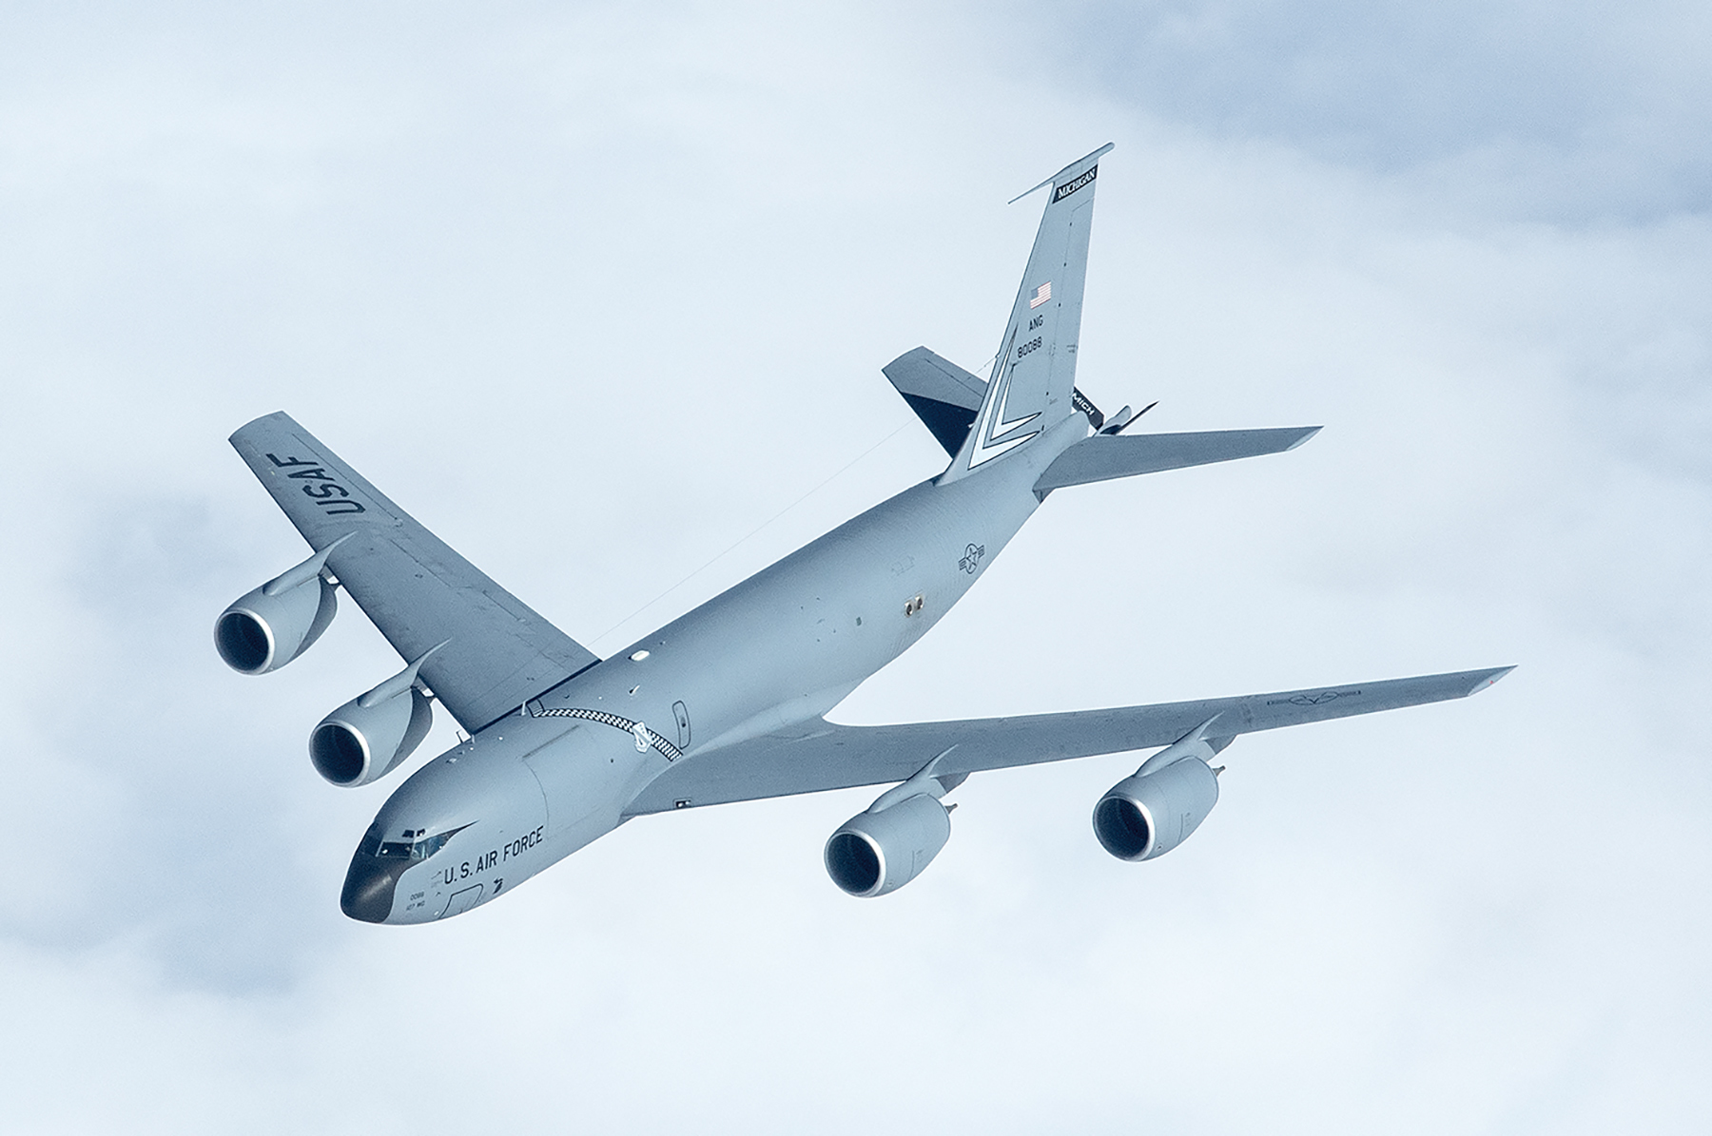
KC-135
Supplying Warfighter Dominance

Slide 61
Housing, Gearbox: CUOH-New Buy Tinker AFB – 421SCMS
MD: | KC135R
TMS: | F108-CF-100
Noun: | Housing, Gearbox (IGB)
NSN: | 2840-01-187-3185
P/N: | 9976M74G04
Buy Price: | $53,624.88
Date Last Procured: | 7/3/2019
Repair Cost: | $18,313.92
AAC: | C
Surplus Available: | 0
QPA/APPL Rate: | 1 | 100%
Replacement Rate: | 0%
AMC/AMSC: | 3 | Z
RMC/RMSC: | 2 | C
Material: | Various Alloys
Dimensions: | 12”L X 12”W X 10”H, 7 LBS
Criticality Code: | Y
Drawings Releasable: | No
Drawing #: | Unavailable
T.O. Releasable: | No
T.O. #: | Unavailable
Budget Code: | 8
Drawing Cage Code:
Next Higher Asmbly: | Inlet Gearbox Assembly
Out Year Requirements: BUY
FY23: | 8 | FY24: | 8 | FY25: | 8 | FY26: | 8 | FY27: | 8
Out Year Requirements: REPAIR
FY23: | 0 | FY24: | 0 | FY25: | 0 | FY26: | 0 | FY27: | 0
EDL: | Unavailable |  |  |  |  | RDL: | Unavailable
Tinker | ------ |  |  |  |  | Robins | 03/24/2023
Hill | ------ |  |  |  |  | Virtual | ------
Comments
Looking for CFM56 suppliers who have inventory of these Housings

Slide 62
Housing, Gearbox: CUOH-New Buy Tinker AFB – 421 SCMS
MD: | KC135R
TMS: | F108-CF-100
Noun: | Housing, Gearbox, Transfer (TGB)
NSN: | 2840-01-199-1547
P/N: | 301-484-017-0
Buy Price: | $40007.86
Date Last Procured: | 12/1/2017
Repair Cost: | $12002.35
AAC: | C
Surplus Available: | 0
QPA/APPL Rate: | 1 | 100%
Replacement Rate: | 0%
AMC/AMSC: | 3 | Z
RMC/RMSC: | 2 | C
Material: | Aluminum Alloy
Dimensions: | 8”L X 8”W X 10” H, 5LBS
Criticality Code: | F
Drawings Releasable: | No
Drawing #: | Unavailable
T.O. Releasable: | No
T.O. #: | Unavailable
Budget Code: | 8
Drawing Cage Code:
Next Higher Asmbly: | Transfer Gearbox Assembly
Out Year Requirements: BUY
FY23: | 9 | FY24: | 9 | FY25: | 9 | FY26: | 9 | FY27: | 9
Out Year Requirements: REPAIR
FY23: | 0 | FY24: | 0 | FY25: | 0 | FY26: | 0 | FY27: | 0
EDL: | Unavailable |  |  |  |  | RDL: | Unavailable
Tinker | ------ |  |  |  |  | Robins | 03/24/2023
Hill | ------ |  |  |  |  | Virtual | ------
Comments
Looking for CFM56 suppliers who have inventory of these Housings

Slide 63
Housing, Gearbox: CUOH-New Buy Tinker AFB – 421 SCMS
MD: | KC135R
TMS: | F108-CF-100
Noun: | Housing, Gearbox (AGB)
NSN: | 2840-01-184-8959
P/N: | 301-484-423-0
Buy Price: | $93,860.00
Date Last Procured: | 11/13/2016
Repair Cost: | $22,584.92
AAC: | M
Surplus Available: | 0
QPA/APPL Rate: | 1 | 100%
Replacement Rate: | 0%
AMC/AMSC: | 3 | Z
RMC/RMSC: | N/A | N/A
Material: | Aluminum Alloy
Dimensions: | 45”L X 15”W X 24”H
Criticality Code: | Y
Drawings Releasable: | No
Drawing #: | Unavailable
T.O. Releasable: | No
T.O. #: | Unavailable
Budget Code: | 8
Drawing Cage Code:
Next Higher Asmbly: | Accessory Drive Gearbox Assy
Out Year Requirements: BUY
FY23: | 4 | FY24: | 4 | FY25: | 4 | FY26: | 4 | FY27: | 4
Out Year Requirements: REPAIR
FY23: | 0 | FY24: | 0 | FY25: | 0 | FY26: | 0 | FY27: | 0
EDL: | Unavailable |  |  |  |  | RDL: | Unavailable
Tinker | ------ |  |  |  |  | Robins | 03/24/2023
Hill | ------ |  |  |  |  | Virtual | ------
Comments
Looking for CFM56 suppliers who have inventory of these Housings

Slide 64
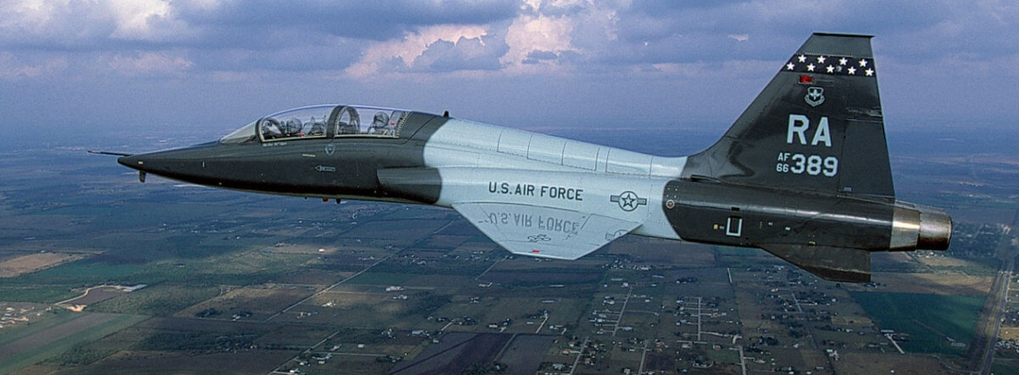
T-38 Talon
Supplying Warfighter Dominance

Slide 65
Positive Clutch: AS – New Buy Hill AFB – 419 SCMS
MD: | T-38
TMS: | N/A
Noun: | Positive Clutch
NSN: | 3010-00-804-9979
P/N: | 3-51260-1
Buy Price: | $44.94
Date Last Procured: | 1/15/2019
Repair Cost: | $0.00
AAC: | D
Surplus Available: | 0
QPA/APPL Rate: | 1 | 100%
Replacement Rate: | 100%
AMC/AMSC: | 1 | G
RMC/RMSC: | N/A | N/A
Material: | Sprag – Steel SAE 52100, Spring – SST Type 301, Rings – Steel SAE 1035
Dimensions: | OD = 1.748, ID = 1.106, Thickness = .750
Criticality Code: | X
Drawings Releasable: | Yes
Drawing #: | 3-51260
T.O. Releasable: | Yes
T.O. #: | 16G1-102-4
Budget Code: | 9
Drawing Cage Code: | 76823
Next Higher Asmbly: | Gearbox Sprag Clutch Gear Assy – 14-51226-1
Out Year Requirements: BUY
FY23: | 240 | FY24: | 240 | FY25: | 240 | FY26: | 240 | FY27: | 240
Out Year Requirements: REPAIR
FY23: | 0 | FY24: | 0 | FY25: | 0 | FY26: | 0 | FY27: | 0
EDL: | Available |  |  |  |  | RDL: | Unavailable
Tinker | ------ |  |  |  |  | Robins | 3/24/2023
Hill | 12/08/2022 |  |  |  |  | Virtual | ------
Comments
The Positive Clutch is used on the T-38 Gearbox and is replaced 100% of the time at overhaul. There are no recent bids on this part, and we need additional sources of manufacture.
Deliverables: Source Approval Request (SAR) Package.
Interested vendors should submit a Source Approval Request (SAR) to dlaavnsmallbus@dla.mil
NOTE: Send notification to 429SCMS.SASPO.Workflow@us.af.mil within 45 days of intent to submit SAR package.

Slide 66
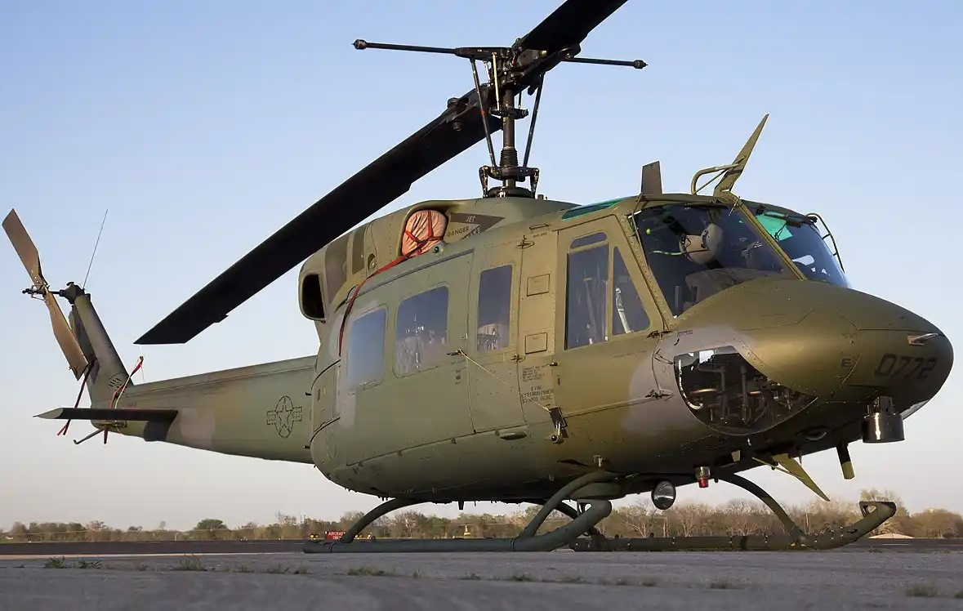
UH-1N Huey

Slide 67
Central Electronics Unit: RD - OTA Robins AFB – 411 SCMS
MD: | UH-1N
TMS: | N/A
Noun: | Central Electronics Unit
NSN: | 5855-01-519-0341
P/N: | 95001150-12
Buy Price: | $99,559.04
Date Last Procured: | 10/25/2012
Repair Cost: | $8,138.21
AAC: | C
Surplus Available: | 0
QPA/APPL Rate: | 1 | 100
Replacement Rate: | 0
AMC/AMSC: | 3 | Z
RMC/RMSC: | 3 | D
Material: | Aluminum; Several CCA and Interconnecting Cables for I/O Data
Dimensions: | 15.1 IN L X 15.1 IN W X 17.55 IN H X 29 LBS
Criticality Code: | X
Drawings Releasable: | No
Drawing #: | NA
T.O. Releasable: | No
T.O. #: | NA
Budget Code: | 8
Drawing Cage Code: | NA
Next Higher Asmbly: | AN/AAQ-36
Out Year Requirements: BUY
FY23: | 0 | FY24: | 0 | FY25: | 0 | FY26: | 0 | FY27: | 0
Out Year Requirements: REPAIR
FY23: | 17 | FY24: | 12 | FY25: | 12 | FY26: | 11 | FY27: | 10
EDL: | Unavailable |  |  |  |  | RDL: | Unavailable
Tinker | ----- |  |  |  |  | Robins | 3/24/2023
Hill | 12/8/2022 |  |  |  |  | Virtual | ------
Comments
Submit questions regarding this item to 429SCMS.SASPO.workflow@us.af.mil
Deliverables: Complete Technical Data Package (TDP) including all repair processes
Interested vendors should submit a White Paper to 429SCMS.SASPO.workflow@us.af.mil

Slide 68
Hand Control Unit: RD - OTA Robins AFB – 411 SCMS
MD: | UH-1N
TMS: | N/A
Noun: | Hand Control Unit
NSN: | 5855-01-519-0343
P/N: | 92004055
Buy Price: | $11,728.08
Date Last Procured: | 8/30/2017
Repair Cost: | $2,784.61
AAC: | C
Surplus Available: | 0
QPA/APPL Rate: | 1 | 100
Replacement Rate: | 0
AMC/AMSC: | 3 | Z
RMC/RMSC: | 4 | R
Material: | Small Box with Control Switches
Dimensions: | 4.6 IN L X 4.5 IN W X 2.5 IN H X 2.5 LBS
Criticality Code: | X
Drawings Releasable: | No
Drawing #: | NA
T.O. Releasable: | No
T.O. #: | NA
Budget Code: | 8
Drawing Cage Code: | NA
Next Higher Asmbly: | HC130N/P FLIR System
Out Year Requirements: BUY
FY23: | 0 | FY24: | 0 | FY25: | 0 | FY26: | 0 | FY27: | 0
Out Year Requirements: REPAIR
FY23: | 22 | FY24: | 11 | FY25: | 11 | FY26: | 10 | FY27: | 9
EDL: | Unavailable |  |  |  |  | RDL: | Unavailable
Tinker | ----- |  |  |  |  | Robins | 3/24/2023
Hill | 12/8/2022 |  |  |  |  | Virtual | ------
Comments
Submit questions regarding this item to 429SCMS.SASPO.workflow@us.af.mil
Deliverables: Complete Technical Data Package (TDP) including all repair processes
Interested vendors should submit a White Paper to 429SCMS.SASPO.workflow@us.af.mil

Slide 69
TFU (FLIR Imaging System): RD - OTA Robins AFB – 411 SCMS
MD: | UH-1
TMS: | N/A
Noun: | TFU (FLIR Imaging System)
NSN: | 5855-01-519-0587
P/N: | 95001250-204
Buy Price: | $518,332.50
Date Last Procured: | 5/12/2008
Repair Cost: | $36,461.89
AAC: | C
Surplus Available: | 0
QPA/APPL Rate: | 1 | 100
Replacement Rate: | 0
AMC/AMSC: | 3 | Z
RMC/RMSC: | 4 | R
Material: | Turrent Assembly
Dimensions: | 15.1 IN L X 10.025 IN W X 17.55 IN H X 98 LBS
Criticality Code: | X
Drawings Releasable: | No
Drawing #: | NA
T.O. Releasable: | No
T.O. #: | NA
Budget Code: | 8
Drawing Cage Code: | NA
Next Higher Asmbly: | AN/AAR-36
Out Year Requirements: BUY
FY23: | 0 | FY24: | 0 | FY25: | 0 | FY26: | 0 | FY27: | 0
Out Year Requirements: REPAIR
FY23: | 16 | FY24: | 5 | FY25: | 4 | FY26: | 3 | FY27: | 3
EDL: | Unavailable |  |  |  |  | RDL: | Unavailable
Tinker | ----- |  |  |  |  | Robins | 3/24/2023
Hill | 12/8/2022 |  |  |  |  | Virtual | ------
Comments
Submit questions regarding this item to 429SCMS.SASPO.workflow@us.af.mil
Deliverables: Complete Technical Data Package (TDP) including all repair processes
Interested vendors should submit a White Paper to 429SCMS.SASPO.workflow@us.af.mil

Slide 70
Cessna R172/7-41 and 150/T-51

Slide 71
Cessna R172/T-41 and 150/T-51 AF Trainers Support: New/Overhauled Mat. – Tinker AFB
Services Required: Seeking New and unused or overhauled material to support USAFA Cessna Trainer Program. This program is supported by a Contractor Logistics Support (CLS) contract.
Scope: Some parts have long mean time between failure with current parts shortage issues due to obsolescence.
Technical Requirements:
Valid 8130-3 tags with 100% traceability to the OEM
Interested & qualified vendors should submit their requests/capabilities to the SASPO workflow: 429SCMS.SASPO.Workflow@us.af.mil
Supplying Warfighter Dominance

Slide 72
Cessna R172/T-41 and 150/T-51 AF Trainers Support: New/Overhauled Mat. – Tinker AFB
0541122-2 –Gear Saddle 2 0541122-1 – Gear Saddle
069-1024-31 – KX-155 Radio S1189-2 – Baggage Door Latch
0592300-11 – Left Hand Fuel Tank 9705-0006-101 – Strobe Relay
0426519-2 – Right Hand Fuel Tank T51 0592300-10 – Right Hand Fuel Tank
00512017-01 – Radio Shelf 0513241-201 – Shock Assy Inst. Panel
0513241-3 – Inst. Panel Stiffener 066-1072-00 – Auto. Direction Finder
0513241-4 – Inst. Panel Bracket 066-1088-00 – Dist. Meas. Equipment
1556026-1 – Elec. Fuel Pump 0716606-4 – Fuel Arm Assembly
0511258-2 – Pilot Side Door Latch Assy

